Slide 1


Slide 2
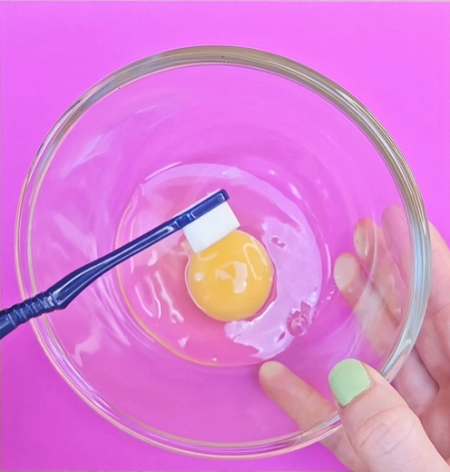

Imagine……
Trying to whisk an egg with a toothbrush
Eating soup with a fork
Cutting down a tree with a knife
Mowing the grass with scissors
Washing the dishes with a dirty sock
Dyslexia Scotland Charity No. SC000951 | dyslexiascotland.org.uk

Slide 3

Having the right tools is important for all of us.
Without the right tools getting the job done can be impossible.
Dyslexia Scotland Charity No. SC000951 | dyslexiascotland.org.uk

Slide 4


Learning is like a job – you need the right tools
We all learn in different ways
Dyslexia is an example of a different way of learning
We all need the right tools for the way we learn
Dyslexia Scotland Charity No. SC000951 | dyslexiascotland.org.uk

Slide 5


How do I ask for the right tools?
I'm confused about/feel stuck around…
I learn best when…
Could I…
It helps me when…
What helps me concentrate is…
What helps me get my ideas out is…
Dyslexia Scotland Charity No. SC000951 | dyslexiascotland.org.uk

Slide 6


Remember…
No one minds you asking. It’s good to ask.
Dyslexia Scotland Charity No. SC000951 | dyslexiascotland.org.uk

Slide 7
For dyslexic learners, the right tools may be…
Dyslexia Scotland Charity No. SC000951 | dyslexiascotland.org.uk

Slide 8

Finding somewhere quiet to concentrate
Dyslexia Scotland Charity No. SC000951 | dyslexiascotland.org.uk

Slide 9

Breaking tasks down into timed chunks
Dyslexia Scotland Charity No. SC000951 | dyslexiascotland.org.uk

Slide 10

Using technology for things like speech to text, text to speech and spellcheck
Dyslexia Scotland Charity No. SC000951 | dyslexiascotland.org.uk

Slide 11

Having extra time to complete work and tests
Dyslexia Scotland Charity No. SC000951 | dyslexiascotland.org.uk

Slide 12

We all need different tools to learn.
What are the right tools for you?
Dyslexia Scotland Charity No. SC000951 | dyslexiascotland.org.uk

