Slide 1





Dyslexia Awareness Week 2026
S1 – S2
Lesson
Charity No. SC 000951
© Wee Coaching Company

Slide 2
Learning Intentions
To understand that some differences and challenges are invisible, and that dyslexia is an example of a hidden challenge.
To be able to choose tools and strategies that help me learn more confidently, comfortably and effectively.
To practise asking for what helps me best (extension activity).
Dyslexia Scotland Charity No. SC000951 | dyslexiascotland.org.uk
© Wee Coaching Company

Slide 3
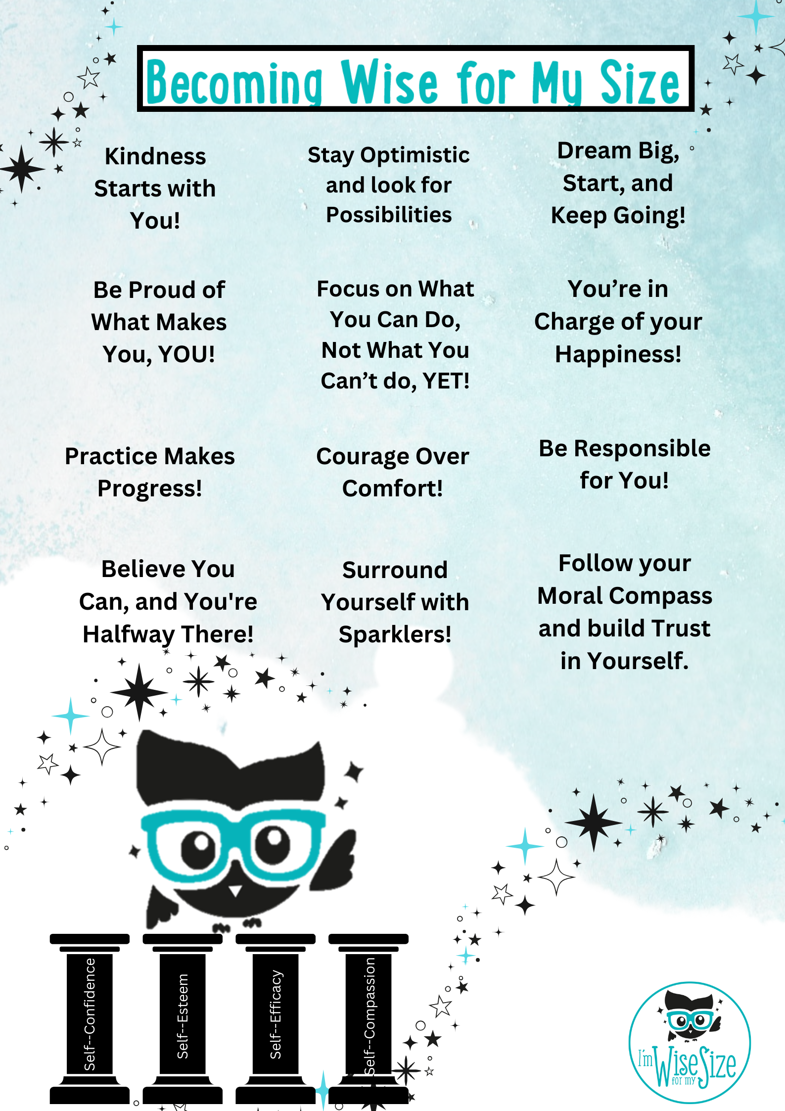
Becoming Wise for
my Size
Dyslexia Scotland Charity No. SC000951 | dyslexiascotland.org.uk
© Wee Coaching Company
Notes:
‘Sparklers’ are the people in your life who cheer you on, are happy to listen to you, support you and want the best for you.

Slide 4
Dyslexia
Dyslexia is when someone's brain learns differently from others. It has nothing to do with intelligence.
If you are dyslexic you might find things like reading and spelling difficult. You might find it harder to hold information in your head or remember things like spoken instructions or directions.
The Wisery
© Wee Coaching Company

Slide 5
Learning Tools
The different strategies, resources or supports that help you learn in the way that works best for you.
The best tools are the ones that help your brain thrive.
The Wisery
© Wee Coaching Company

Slide 6
Environment
The place around you where you learn, play or spend time. Small changes to your environment can help you feel calmer, more focused, and ready to do your best.
The Wisery
© Wee Coaching Company

Slide 7
Self-Advocacy
The Wisery
Understanding what helps you learn and grow, then confidently asking for the support or changes you need to do your best.
© Wee Coaching Company

Slide 8
We Share
Dyslexia Scotland Charity No. SC000951 | dyslexiascotland.org.uk
© Wee Coaching Company

Slide 9
Reflection Questions
How did the fable make you think or feel?
What did it remind you of?
What do you think Cass understood about Little Flower that others might have missed?
Do you agree with how Cass responded? Why or why not?
© Wee Coaching Company
Notes:
Share the short fable version of Cass and the Little Flower – PDF in Teacher Resources.

Slide 10





Slide 11
What are the right
learning tools for me?
Dyslexia Scotland Charity No. SC000951 | dyslexiascotland.org.uk
© Wee Coaching Company

Slide 12
We Experiment
Dyslexia Scotland Charity No. SC000951 | dyslexiascotland.org.uk
© Wee Coaching Company

Slide 13
The three learning tools
that helped the
most were…
Dyslexia Scotland Charity No. SC000951 | dyslexiascotland.org.uk
© Wee Coaching Company

Slide 14
Becoming Wise for
my Size
Nominations
Dyslexia Scotland Charity No. SC000951 | dyslexiascotland.org.uk
© Wee Coaching Company

Slide 15
Extension Ideas
Self-Advocacy: Understanding what helps you learn and grow, then confidently asking for the support or changes you need to do your best.
Role play in pairs or small groups, practising self-advocacy phrases:
I'm confused about/feel stuck around…
I learn best when…
Could I…
It helps me when…
What helps me concentrate is…
What helps me get my ideas out is…
Dyslexia Scotland Charity No. SC000951 | dyslexiascotland.org.uk
© Wee Coaching Company

Slide 16
Extension Ideas
Write or draw one sentence or phrase you could use to ask a teacher for a learning tool or strategy you need.
Evaluate why offering the same support to every learner might not work - use evidence from today's lesson to justify your answer.
Dyslexia Scotland Charity No. SC000951 | dyslexiascotland.org.uk
© Wee Coaching Company

