Slide 1





Dyslexia Awareness Week 2026
P4-P7
Lesson 3
Charity No. SC 000951
© Wee Coaching Company

Slide 2
Learning Intentions
To be able to choose learning tools and strategies that help me learn more confidently, comfortably and effectively.
To practise asking for what I need to learn best.
Dyslexia Scotland Charity No. SC000951 | dyslexiascotland.org.uk
© Wee Coaching Company

Slide 3
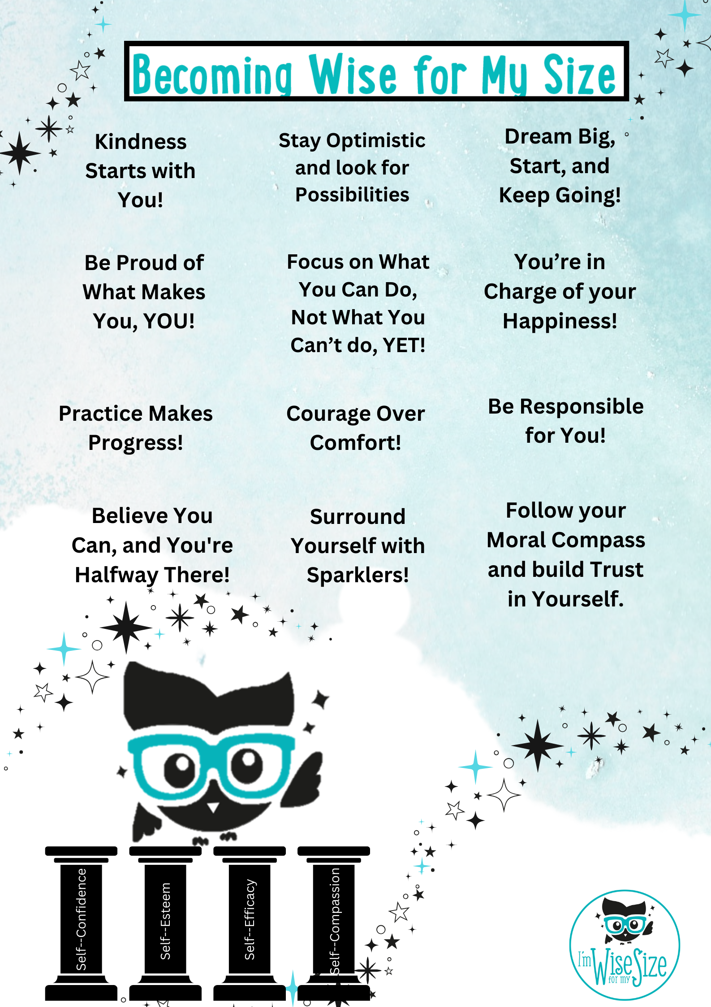
Becoming Wise for
my Size
Dyslexia Scotland Charity No. SC000951 | dyslexiascotland.org.uk
© Wee Coaching Company
Notes:
The Becoming Wise for My Size Poster is a coaching tool that helps create a curious, empathetic ethos in your classroom while pupils explore and experiment.
Draw attention to some of the phrases, for example ‘Practice makes progress’ and discuss with the children what this could mean and ask for an example. Continue with 3 or 4 other phrases.
Encourage pupils to notice moments when they, or others, behave in a “Wise for My Size” way, remind them that you will be looking out for these behaviours as well.
Tell the children that at the end of the lesson they will be able to nominate a fellow pupil or teacher who they feel are becoming Wise for My Size, for example: “I'd like to nominate Vicky because she chose courage over comfort when she told us how it feels for her to read out loud,”
Children can also nominate themselves for example “I'd like to nominate myself because I was a Sparkler for my friend when he tried a new learning tool.”

Slide 4
Learning Tools
The different strategies, resources or supports that help you learn in the way that works best for you.
The best tools are the ones that help your brain thrive.
The Wisery
© Wee Coaching Company

Slide 5
Environment
The place around you where you learn, play or spend time.
Small changes to your environment can help you feel calmer, more focused, and ready to do your best.
The Wisery
© Wee Coaching Company

Slide 6
Self-Advocacy
The Wisery
Understanding what helps you learn and grow, then confidently asking for the support or changes you need to do your best.
© Wee Coaching Company

Slide 7
What are the right
tools for me?
Dyslexia Scotland Charity No. SC000951 | dyslexiascotland.org.uk
© Wee Coaching Company

Slide 8
The three tools that helped my brain thrive the most were…
Dyslexia Scotland Charity No. SC000951 | dyslexiascotland.org.uk
© Wee Coaching Company

Slide 9
Self-Advocacy
Understanding what helps you learn and grow, then confidently asking for the support or changes you need to do your best.
Role play in pairs, practising self-advocacy phrases:
I'm confused about/feel stuck around…
I learn best when…
Could I…
It helps me when…
What helps me concentrate is…
What helps me get my ideas out is…
Dyslexia Scotland Charity No. SC000951 | dyslexiascotland.org.uk

Slide 10
Becoming Wise for
my Size
Nominations
Dyslexia Scotland Charity No. SC000951 | dyslexiascotland.org.uk
© Wee Coaching Company

Slide 11
Extension Ideas
Circle one tool that you'd like to try and practise.
Write/draw one sentence/phrase you could use to ask a teacher for a learning tool you need.
Mystery Learner. Give learners a short profile about a child who is not thriving and learning. Ask: If you were Cass, what would you notice? What questions would you ask? What might you change? What might you change to make their learning easier?
Dyslexia Scotland Charity No. SC000951 | dyslexiascotland.org.uk
© Wee Coaching Company

