Slide 1





Dyslexia Awareness
Week 2026
P4-P7
Lesson Two
Charity No. SC 000951
© Wee Coaching Company

Slide 2
Learning Intentions
I understand that everyone needs different tools and approaches to thrive and that makes us stronger.
Dyslexia Scotland Charity No. SC000951 | dyslexiascotland.org.uk
© Wee Coaching Company

Slide 3
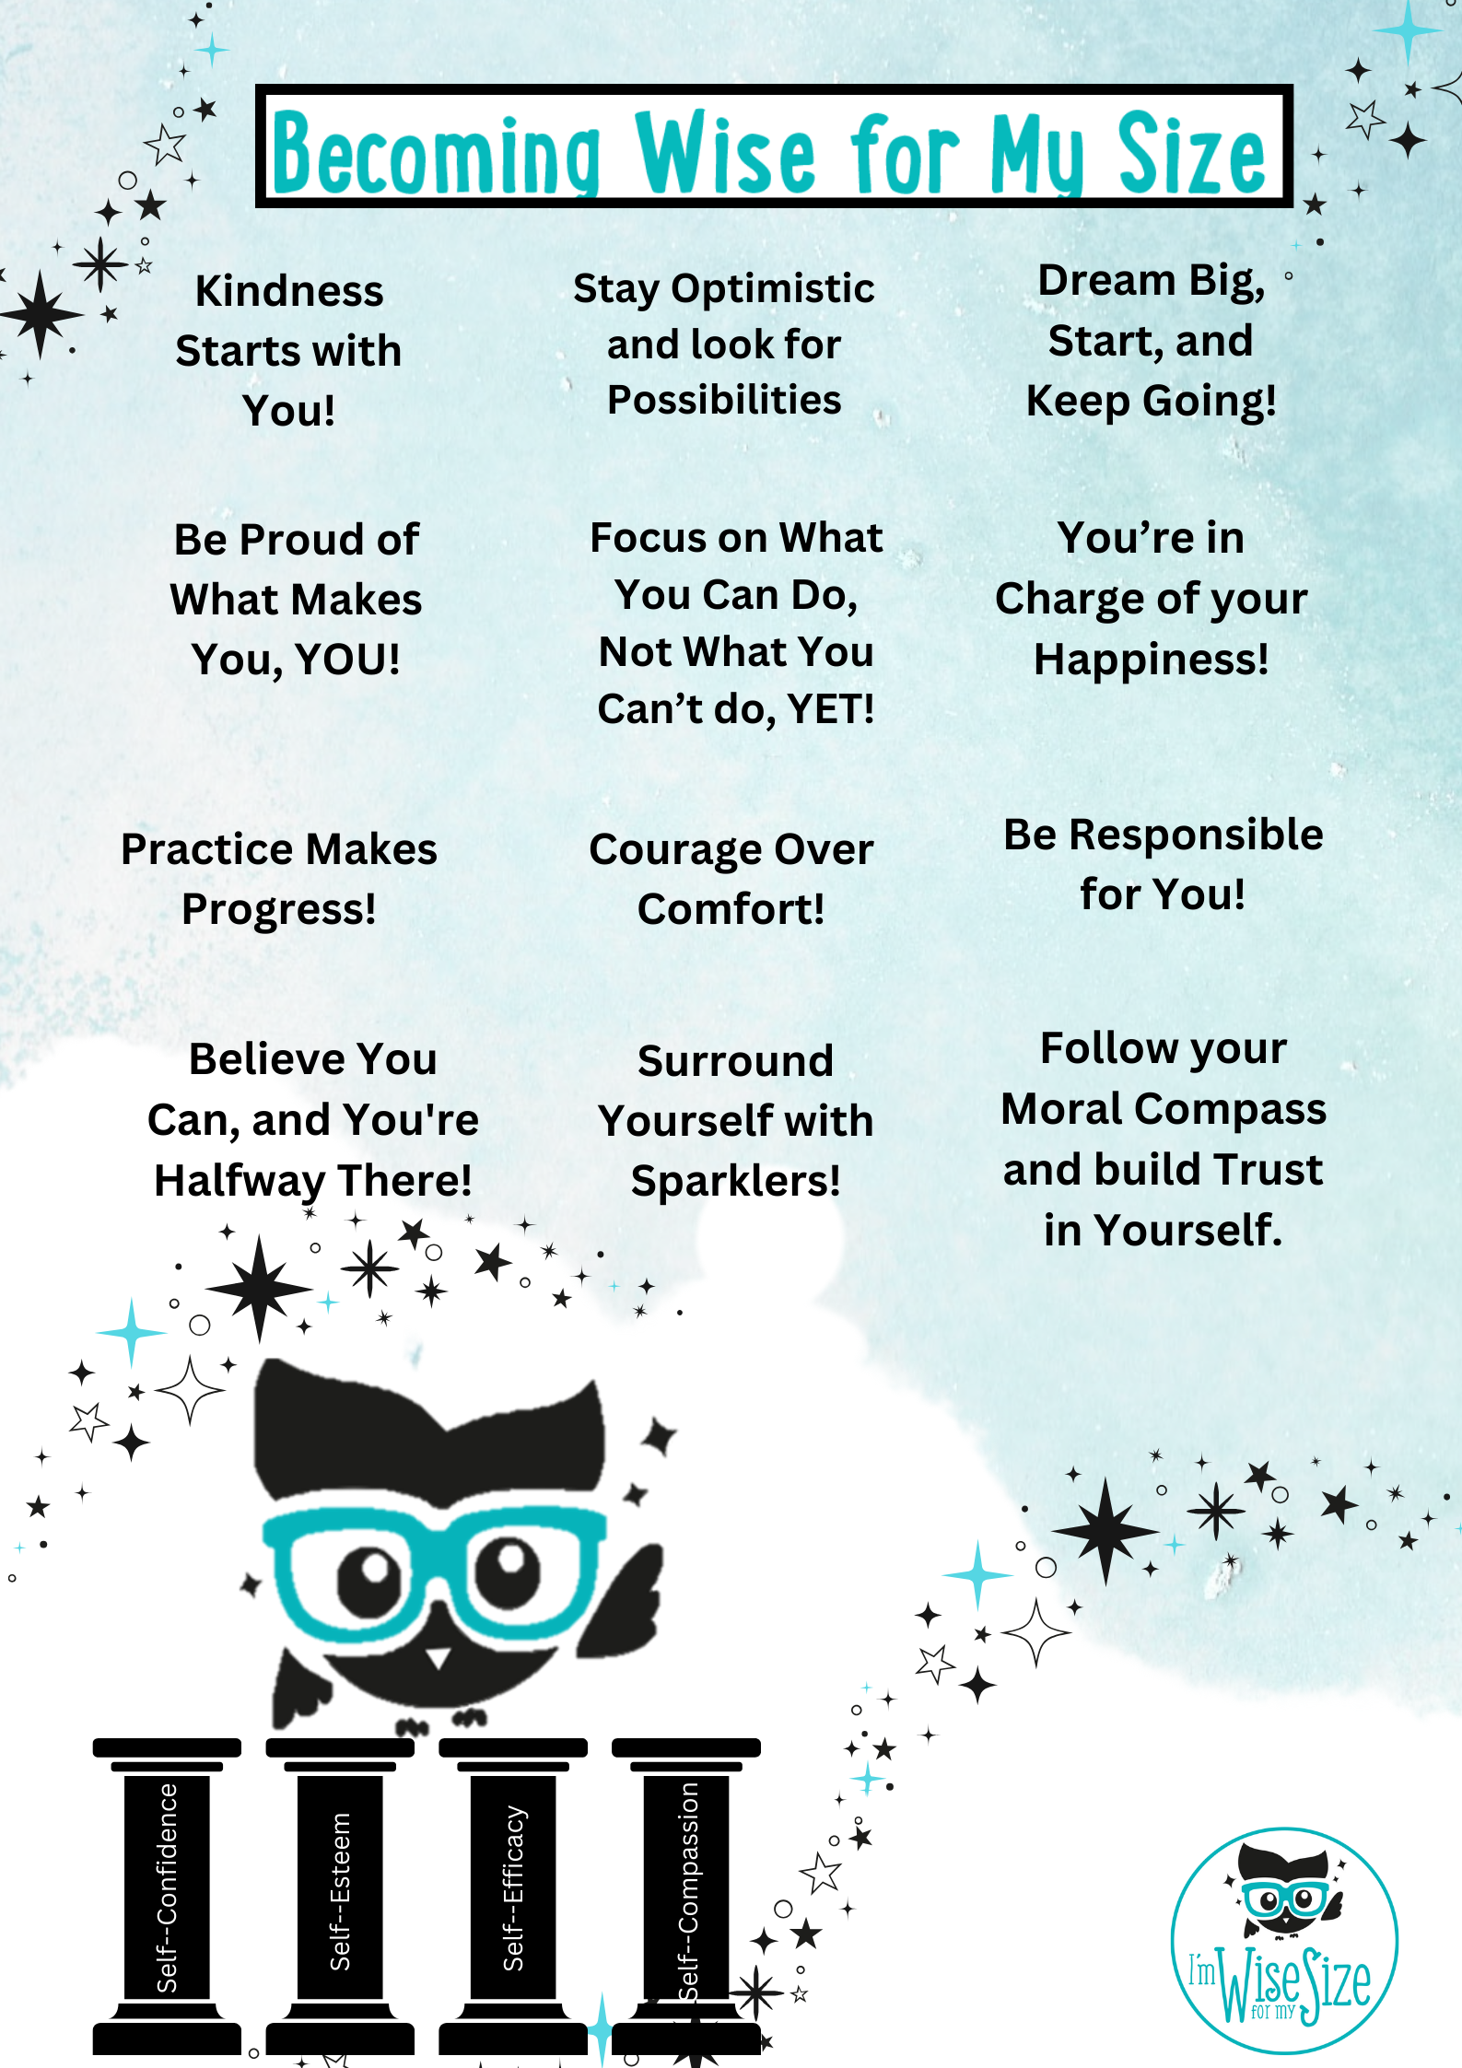
Becoming Wise for
my Size
Dyslexia Scotland Charity No. SC000951 | dyslexiascotland.org.uk
© Wee Coaching Company
Notes:
‘Sparklers’ are the people in your life who cheer you on, are happy to listen to you, support you and want the best for you.

Slide 4
Neurodiversity
Everyone's brain works in its own unique way. Different brains have different strengths, and together those differences make our world brighter, kinder and more creative.
The Wisery
© Wee Coaching Company

Slide 5
Biodiversity
Having lots of different living things - plants, animals, insects, trees - all sharing the same world. Nature is stronger because of its variety and difference.
The Wisery
© Wee Coaching Company

Slide 6
Personal Strengths
Qualities such as kindness, courage, creativity, determination, curiosity, honesty and humour. Everyone has their own unique mixture - the trick is to know yours and build on them.
The Wisery
© Wee Coaching Company

Slide 7
Uniqueness
Everyone is different and has their own special talents and challenges.
The Wisery
© Wee Coaching Company

Slide 8
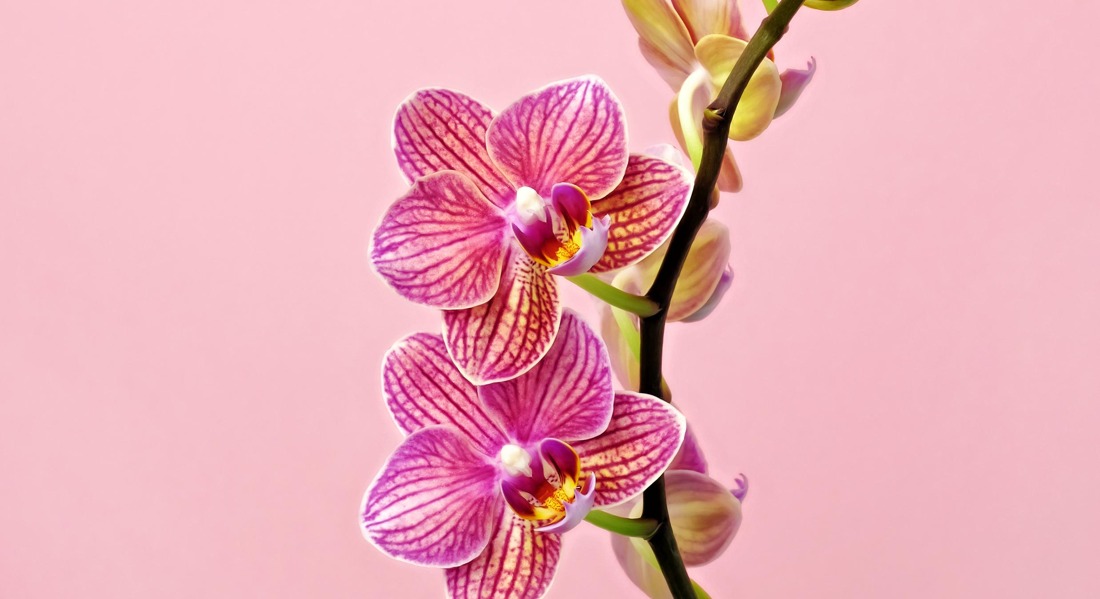

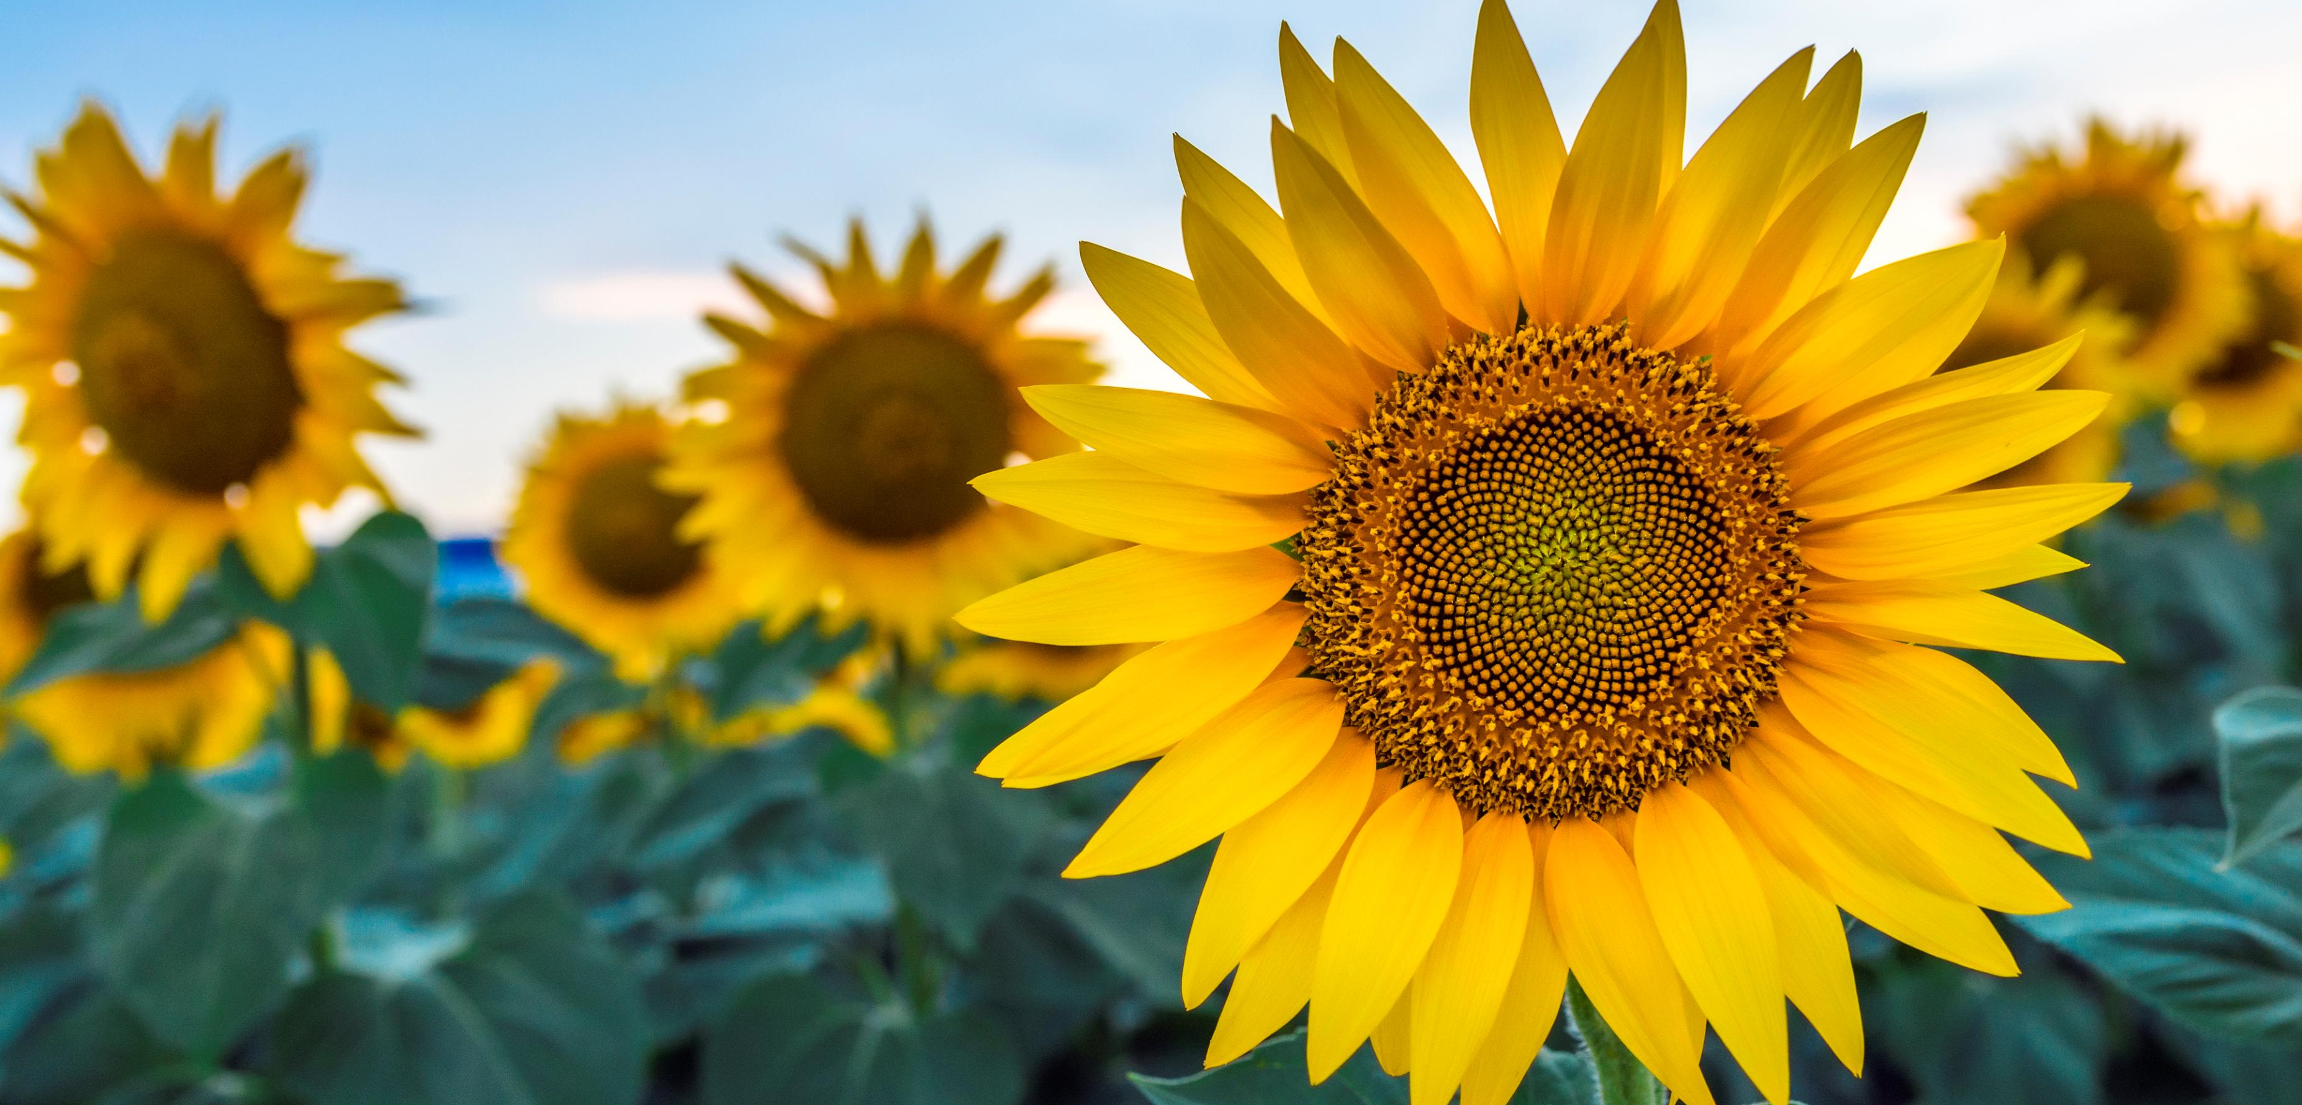
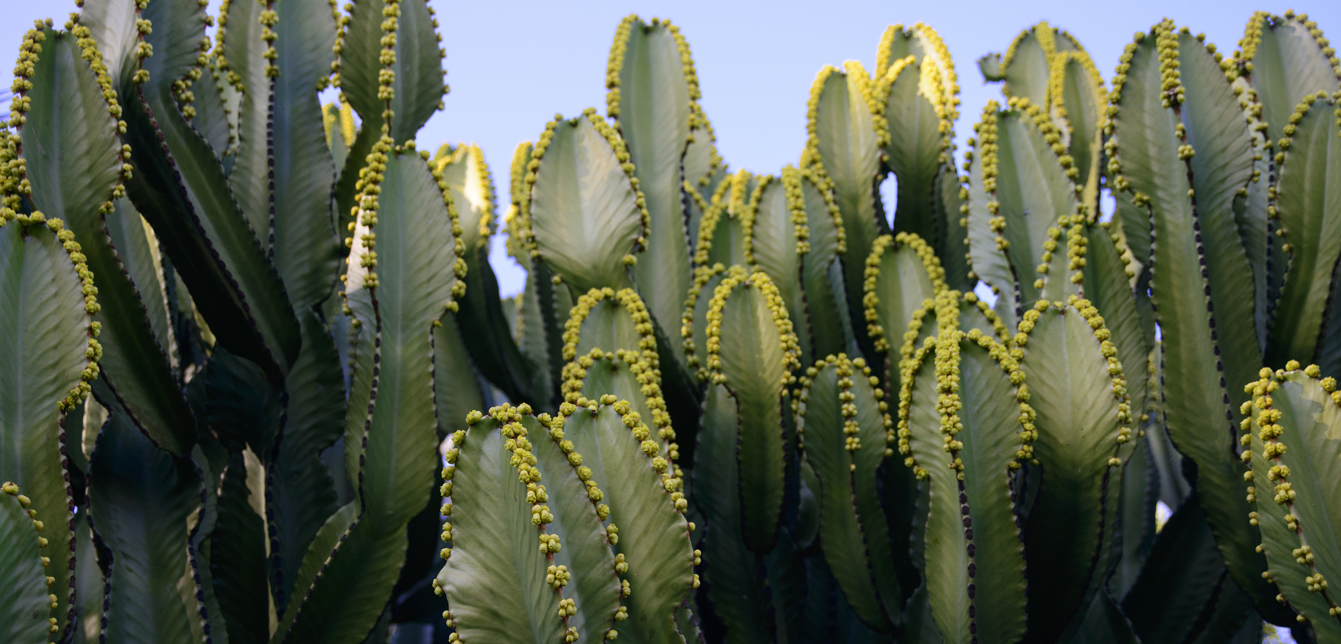
Notes:
Where would each plant bloom?

Slide 9
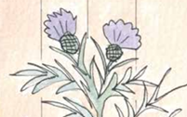
What would happen if we were all the same?
Dyslexia Scotland Charity No. SC000951 | dyslexiascotland.org.uk
© Wee Coaching Company

Slide 10
If we were all the same, what could we miss out on?
New ideas
Fewer fresh ways to solve problems
Creativity
Everyone picturing the same thing
Different strengths
No one to fill the gaps we each leave
Dyslexia Scotland Charity No. SC000951 | dyslexiascotland.org.uk
© Wee Coaching Company

Slide 11
We Reflect
We all like different things.
How can our different ideas, skills and favourite things help us all to thrive?
Dyslexia Scotland Charity No. SC000951 | dyslexiascotland.org.uk
© Wee Coaching Company

Slide 12
Becoming Wise for my Size
Nominations
Dyslexia Scotland Charity No. SC000951 | dyslexiascotland.org.uk
© Wee Coaching Company

Slide 13
Extension Ideas
Explain in a sentence or two why a class full of people who all learnt in the same way might struggle to solve a problem.
Create a story/comic strip about a world where everyone is the same. What could be the challenges?
Research a plant and find out where it should be planted to help it thrive.
Dyslexia Scotland Charity No. SC000951 | dyslexiascotland.org.uk
© Wee Coaching Company

