Slide 1





Dyslexia Awareness Week 2026
P4-P7
Lesson 1
Charity No. SC 000951
© Wee Coaching Company

Slide 2
Learning Intentions
I recognise the Four Well-being Pillars; self-esteem, self-confidence, self-compassion and self-efficacy, in myself and others, and understand that we all need different things to thrive.
I am learning to understand that some differences and challenges are invisible, and that dyslexia is an example of a hidden difference.
Dyslexia Scotland Charity No. SC000951 | dyslexiascotland.org.uk
© Wee Coaching Company
Notes:
I

Slide 3
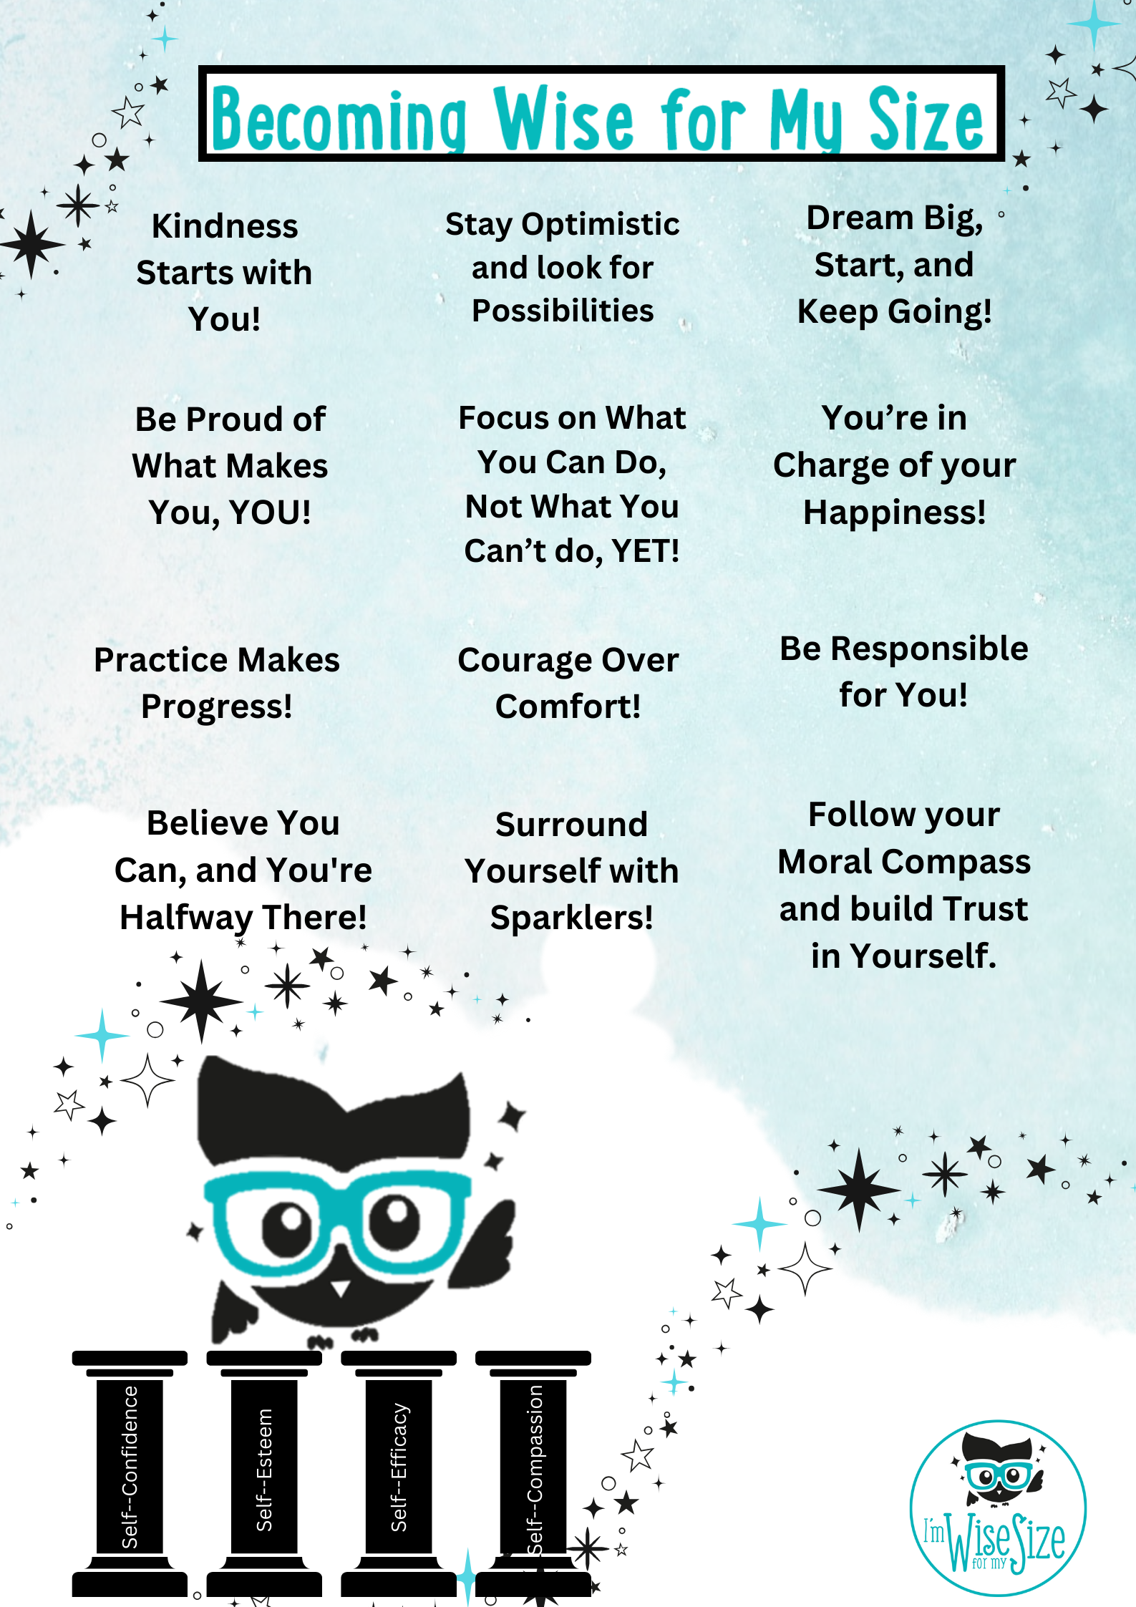
Becoming Wise for
my Size
Dyslexia Scotland Charity No. SC000951 | dyslexiascotland.org.uk
© Wee Coaching Company
Notes:
‘Sparklers’ are the people in your life who cheer you on, are happy to listen to you, support you and want the best for you.

Slide 4
Self-Confidence
Believing in yourself and developing “push-me-forward” beliefs that help you take on tasks of any size, face challenges and overcome obstacles.
The Wisery
© Wee Coaching Company
Notes:
The Wisery is used within the Wise for My Size method to create a shared language and understanding between everyone. It is like a wise dictionary.

Slide 5
Self-Esteem
Loving yourself, recognising your worth, and feeling proud of the unique qualities that make you who you are.
The Wisery
© Wee Coaching Company

Slide 6
Self-Compassion
Being kind to yourself when things feel hard, and responding to challenges with patience, understanding and encouragement rather than criticism.
The Wisery
© Wee Coaching Company

Slide 7
Self-Efficacy
Choosing to believe you can influence a positive outcome and contribute to your own success.
The Wisery
© Wee Coaching Company

Slide 8
Dyslexia
Dyslexia is when someone’s brain learns differently from others. It has nothing to do with intelligence.
If you are dyslexic you might find things like reading and spelling difficult. You might find it harder to hold information in your head or remember things like spoken instructions or directions.
The Wisery
© Wee Coaching Company

Slide 9

Dyslexia Scotland Charity No. SC000951 | dyslexiascotland.org.uk
© Wee Coaching Company

Slide 10
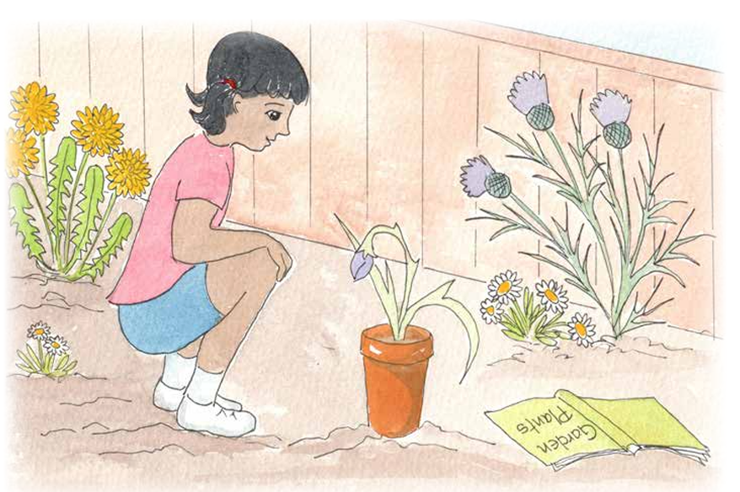
Dyslexia Scotland Charity No. SC000951 | dyslexiascotland.org.uk
© Wee Coaching Company

Slide 11
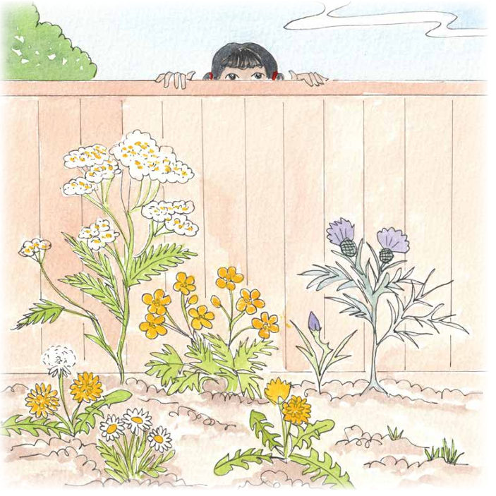
Dyslexia Scotland Charity No. SC000951 | dyslexiascotland.org.uk
© Wee Coaching Company

Slide 12
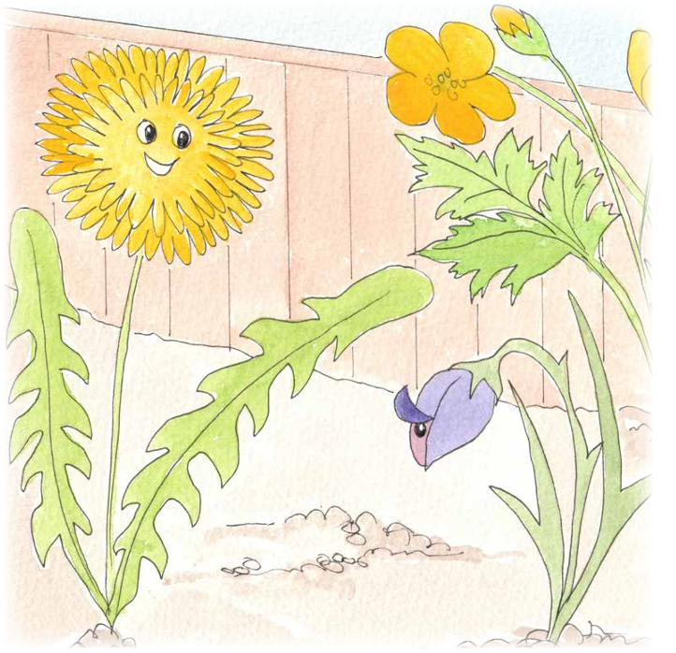
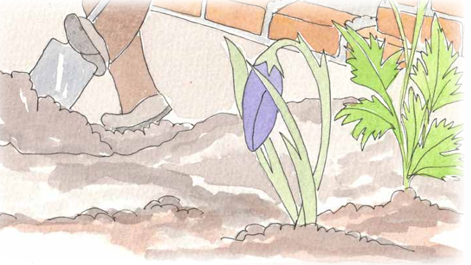
Dyslexia Scotland Charity No. SC000951 | dyslexiascotland.org.uk

Slide 13
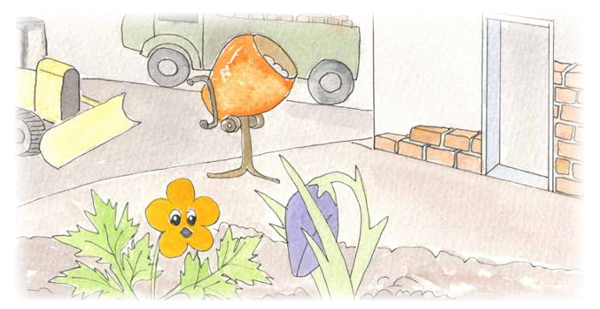
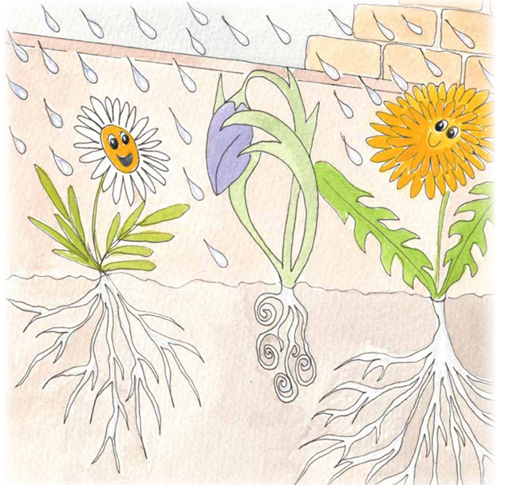
Dyslexia Scotland Charity No. SC000951 | dyslexiascotland.org.uk
© Wee Coaching Company

Slide 14
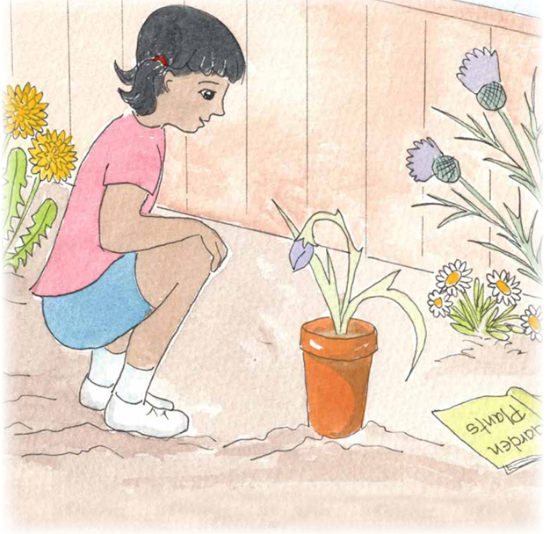
Dyslexia Scotland Charity No. SC000951 | dyslexiascotland.org.uk
© Wee Coaching Company

Slide 15
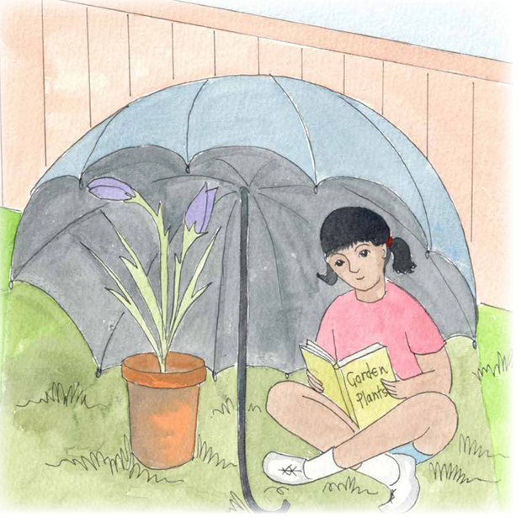
Dyslexia Scotland Charity No. SC000951 | dyslexiascotland.org.uk
© Wee Coaching Company

Slide 16
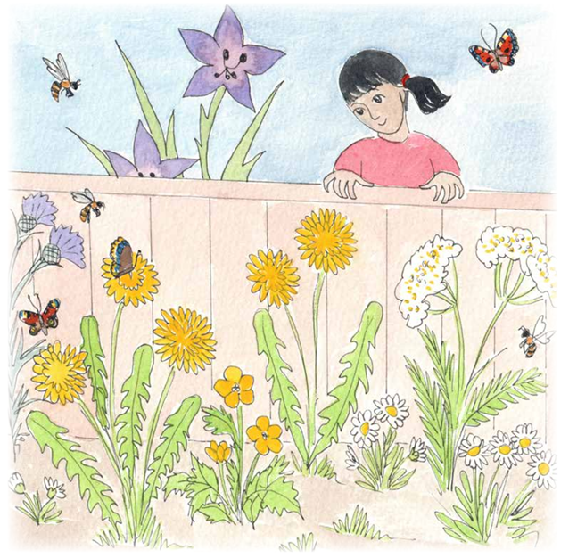
Dyslexia Scotland Charity No. SC000951 | dyslexiascotland.org.uk
© Wee Coaching Company

Slide 17

Reflection Questions
How did the story make you feel?
When have you felt this way before?
What did you like about the story?
Who was your favourite character?
Who was your least favourite character?
What could this story teach you?
How would that help you?
What do you think happens next?
© Wee Coaching Company

Slide 18
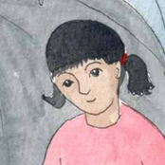
Walk in their Shoes
Being Cass
How did you know Little Flower was not happy?
How did you know how to help Little Flower?
How did you feel when Little Flower blossomed?
© Wee Coaching Company

Slide 19
Walk in their Shoes
Being Little Flower
What was making you so upset and frightened?
How did you feel when the other flowers suggested that you should feel less?
How did you feel when you realised you were not like the other flowers?
What did YOU need to grow big and thrive?
© Wee Coaching Company

Slide 20
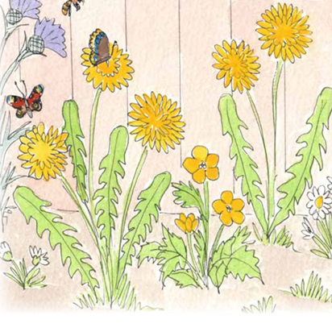
Walk in their Shoes
Being the other flowers
You were trying to help by suggesting Little Flower acted more like you, why was this?
How did you all feel when you saw Little Flower had bloomed?
How could you be more like Cass the next time a flower in the garden is not blooming?
© Wee Coaching Company

Slide 21
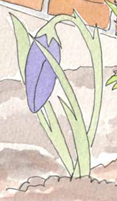
What could Cass See?
What could she see?
Drooped petals, small size, shaking, hiding from the heat.
What was hidden? Burning heat on petals, wet soggy roots, the loud noise of the lorries.
© Wee Coaching Company

Slide 22
What if Little Flower was a child?
What would you see?
What could be hidden?
© Wee Coaching Company

Slide 23
We Reflect
What could today's session teach me?
How could that help me and others?
Dyslexia Scotland Charity No. SC000951 | dyslexiascotland.org.uk
© Wee Coaching Company

Slide 24
Becoming Wise for
my Size
Nominations
Dyslexia Scotland Charity No. SC000951 | dyslexiascotland.org.uk
© Wee Coaching Company

Slide 25
Extension Ideas
Cass was a Sparkler (cheered her on) for Little Flower. Who are your Sparklers? Activity sheet.
Draw or write about a time something felt hard to do by yourself. How did you feel? What or who helped?
Pretending to be Cass, write a short diary entry about how watching Little Flower helped you understand hidden differences.
Dyslexia Scotland Charity No. SC000951 | dyslexiascotland.org.uk
© Wee Coaching Company

