Slide 1





Dyslexia Awareness Week 2026
P1-3
Lesson 1
Charity No. SC 000951
© Wee Coaching Company

Slide 2
Learning Intentions
I can identify what makes me feel proud, brave, kind and able to try
I understand that everyone needs different things to grow
I know that some things about people are hidden and that dyslexia is one example of this.
Dyslexia Scotland Charity No. SC000951 | dyslexiascotland.org.uk
© Wee Coaching Company

Slide 3
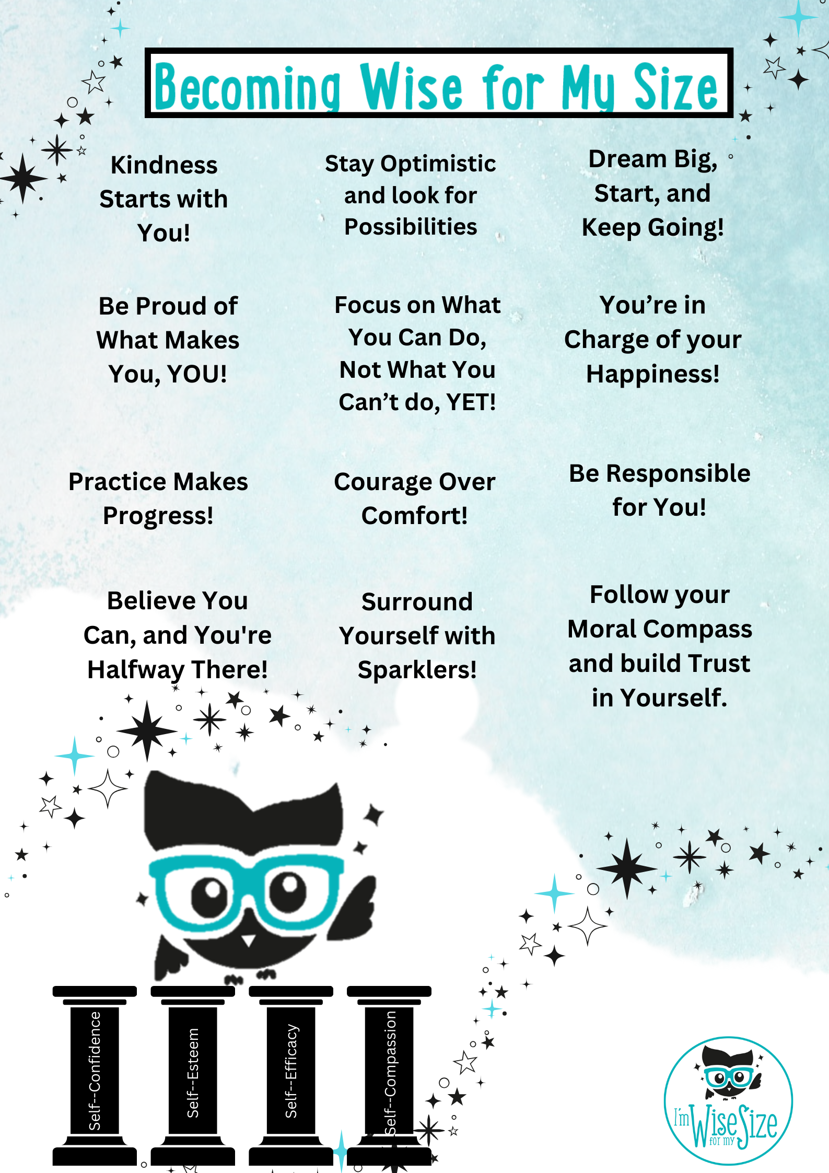
Becoming Wise for
my Size
Dyslexia Scotland Charity No. SC000951 | dyslexiascotland.org.uk
© Wee Coaching Company
Notes:
‘Sparklers’ are the people in your life who cheer you on, are happy to listen to you, support you and want the best for you.

Slide 4
Self-Confidence
Believing, “I can try,” even when something feels tricky.
The Wisery
© Wee Coaching Company
Notes:
The Wisery is used within the Wise for My Size method to create a shared language and understanding between everyone. It is like a wise dictionary.

Slide 5
Self-Esteem
Liking yourself and feeling proud of the things that make you special.
The Wisery
© Wee Coaching Company

Slide 6
Self-Compassion
Being kind to yourself when something is hard, just like you would be kind to a friend.
The Wisery
© Wee Coaching Company

Slide 7
Self-Efficacy (Ability)
Knowing that what you do can help things get better, especially when you keep trying.
The Wisery
© Wee Coaching Company

Slide 8

Dyslexia Scotland Charity No. SC000951 | dyslexiascotland.org.uk
© Wee Coaching Company

Slide 9
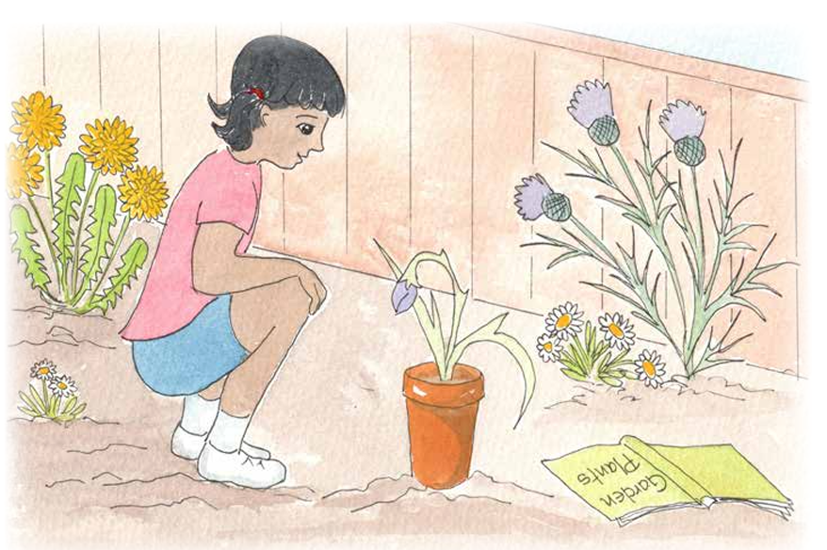
Dyslexia Scotland Charity No. SC000951 | dyslexiascotland.org.uk
© Wee Coaching Company

Slide 10
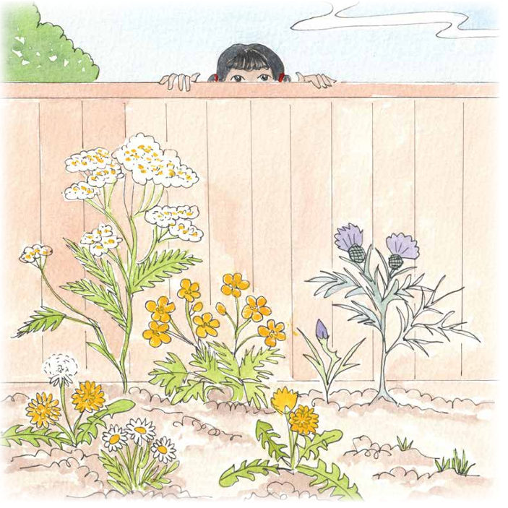
Dyslexia Scotland Charity No. SC000951 | dyslexiascotland.org.uk

Slide 11
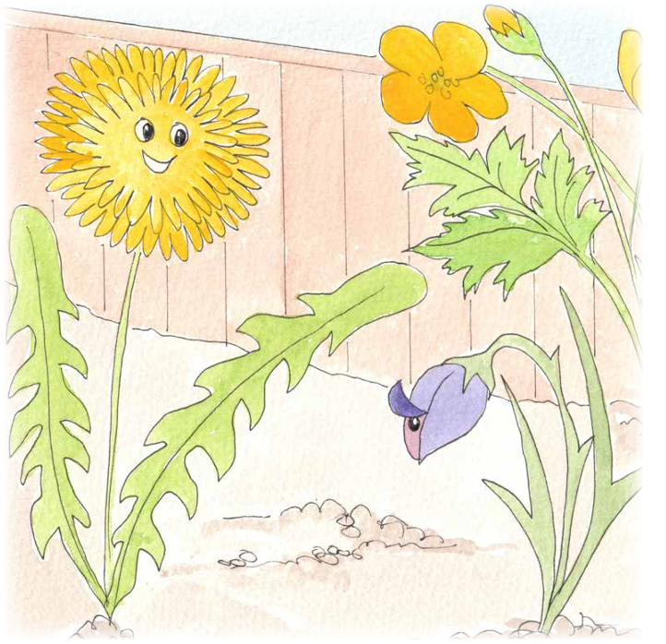
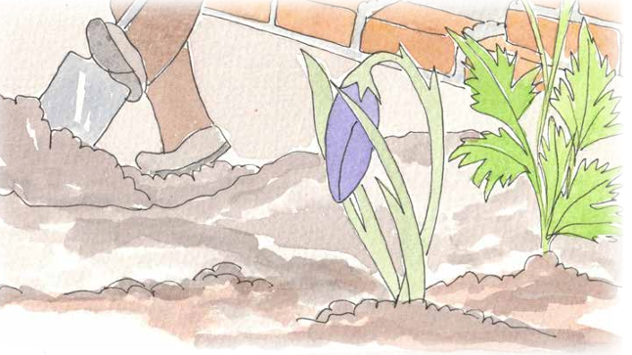
Dyslexia Scotland Charity No. SC000951 | dyslexiascotland.org.uk
© Wee Coaching Company

Slide 12
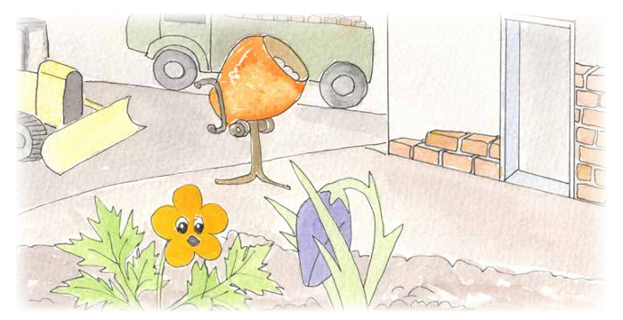
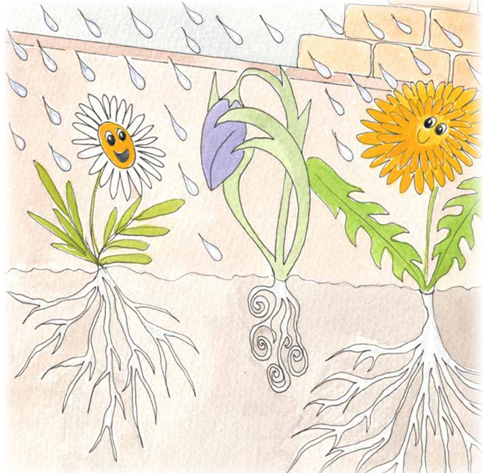
Dyslexia Scotland Charity No. SC000951 | dyslexiascotland.org.uk
© Wee Coaching Company

Slide 13
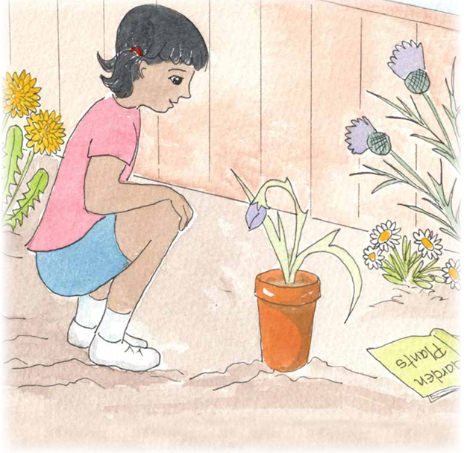
Dyslexia Scotland Charity No. SC000951 | dyslexiascotland.org.uk
© Wee Coaching Company

Slide 14
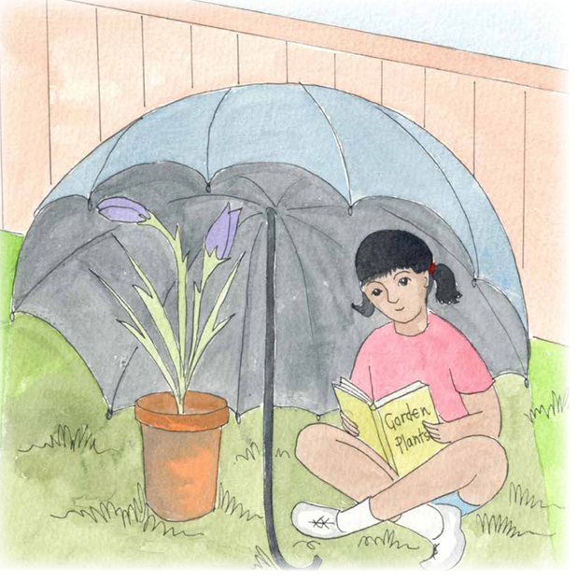
Dyslexia Scotland Charity No. SC000951 | dyslexiascotland.org.uk
© Wee Coaching Company

Slide 15
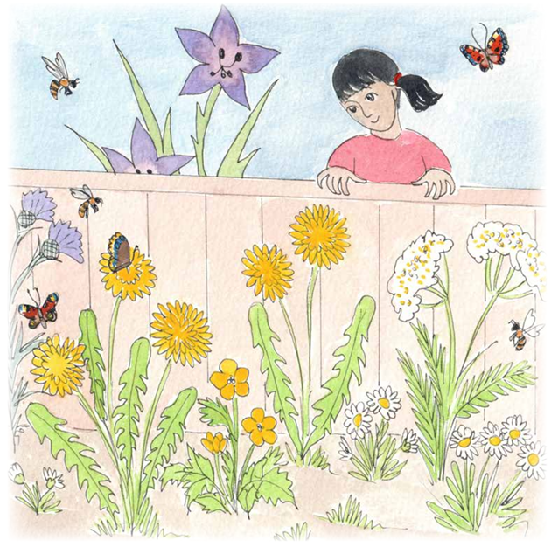
Dyslexia Scotland Charity No. SC000951 | dyslexiascotland.org.uk
© Wee Coaching Company

Slide 16

Reflection Questions
How did the story make you feel?
When have you felt like that?
What bit did you like best?
What could the story teach you?
How can that help you?
What might happen next?
© Wee Coaching Company

Slide 17
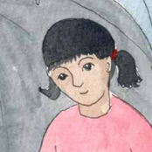
Walk in their Shoes
Being Cass
How did you know Little Flower was not happy?
How did you feel when Little Flower blossomed?
© Wee Coaching Company

Slide 18
Walk in their Shoes
Being Little Flower
What was making you so upset and frightened?
What did you need to grow big and thrive?
© Wee Coaching Company

Slide 19
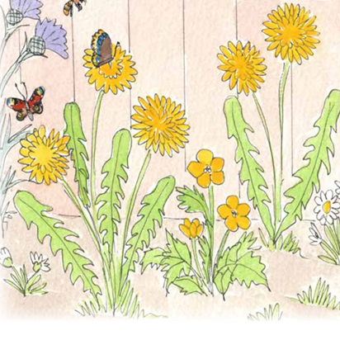
Walk in their Shoes
Being the other flowers
How did you all feel when you saw Little Flower had bloomed?
How could you be more like Cass the next time a flower in the garden is not blooming?
© Wee Coaching Company

Slide 20
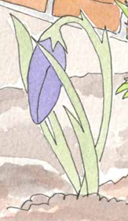
Hidden differences
What could Cass See?
What could she see?
Petals drooping, small size, shaking, hiding from the sun.
What was hidden?
Burning heat on petals, wet soggy roots, the loud noise of the lorry.
© Wee Coaching Company
Notes:
Show the picture of Little Flower. Ask: How did Cass help Little Flower? Help the children see that Cass looked closely. Cass noticed what helped Little Flower and what did not help. Some things were easy to see. Little Flower’s petals were curling. Some things were harder to see. Little Flower did not like the loud noise. Cass changed the place around Little Flower. Cass did not say Little Flower was wrong. Cass saw that Little Flower needed something different.

Slide 21
What if Little Flower was a child?
What would you see?
What could be hidden?
© Wee Coaching Company
Notes:
If we imagine Little Flower as a child in the classroom who was finding things difficult. What might we be able to observe (actions, behaviours, things they might say, attitude, emotions) and what could be invisible? (thoughts, worries, beliefs)
Dyslexia is an example of a hidden difference. Dyslexia means your brain learns words in its own way. A child with dyslexia may need more time to listen, think and answer. Pictures can help. Saying words, reading words and spelling words might feel tricky. That is okay. We can all learn in different ways.
Little Flower was not naughty or wrong. Little Flower just needed help. Children are like that too. This Dyslexia Awareness week, we will be curious like Cass. We will learn that everyone can grow and learn when they get the help they need.

Slide 22
We Reflect
What could today's session teach me?
How could that help me and others?
Dyslexia Scotland Charity No. SC000951 | dyslexiascotland.org.uk
© Wee Coaching Company

Slide 23
Becoming
Wise for
my Size
Nominations
Dyslexia Scotland Charity No. SC000951 | dyslexiascotland.org.uk
© Wee Coaching Company

Slide 24
Extension Ideas
Retell the story in your own words, using pictures or puppets to help.
Draw a picture of the ways Cass helped Little Flower to bloom and thrive.
Dyslexia Scotland Charity No. SC000951 | dyslexiascotland.org.uk
© Wee Coaching Company

