Slide 1





Dyslexia Awareness Week 2026
P1-P3
Lesson 2
Charity No. SC 000951
© Wee Coaching Company

Slide 2
Learning Intentions
I understand that all people are different and that’s a good thing
Everyone learns in their own way and dyslexia is an example of this
I am learning to show the things that help me learn and feel good.
Dyslexia Scotland Charity No. SC000951 | dyslexiascotland.org.uk
© Wee Coaching Company

Slide 3
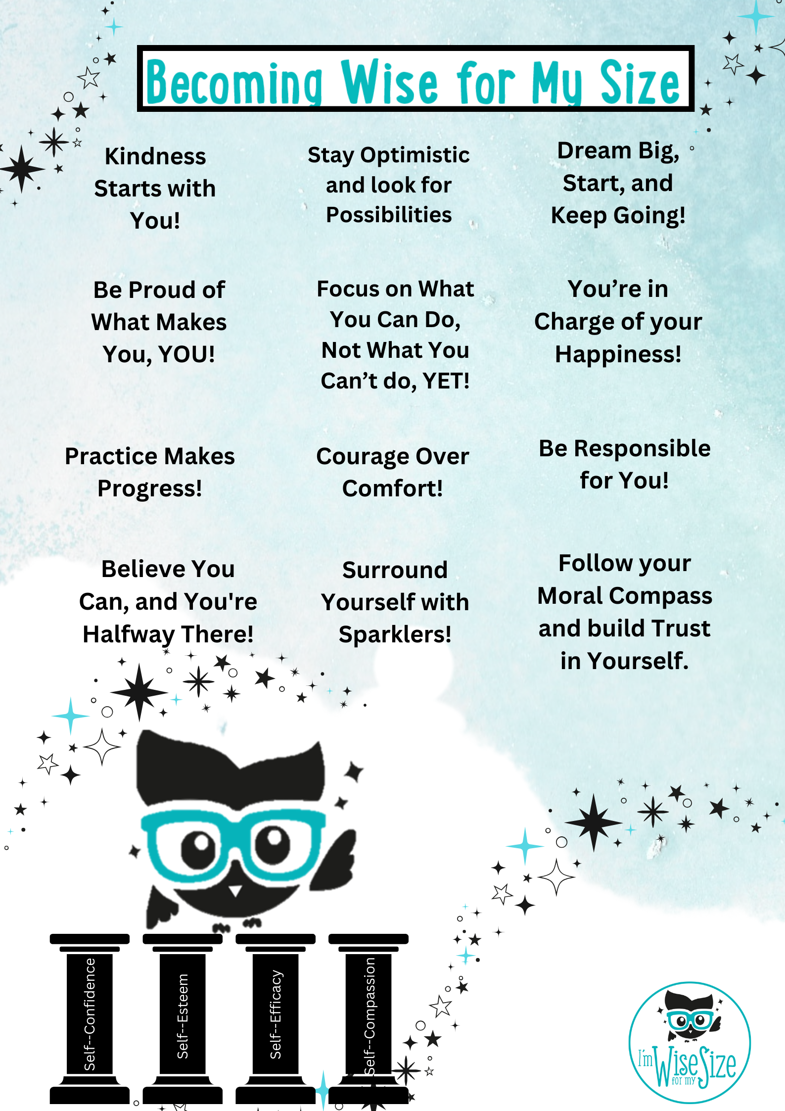
Becoming Wise for
my Size
Dyslexia Scotland Charity No. SC000951 | dyslexiascotland.org.uk
© Wee Coaching Company
Notes:
‘Sparklers’ are the people in your life who cheer you on, are happy to listen to you, support you and want the best for you.

Slide 4
Different
Everyone's brain works in its own unique way. Different brains have different strengths, and together those differences make our world brighter, kinder and more creative.
The Wisery
© Wee Coaching Company

Slide 5
My Unique Strengths
The things I am good at. Everyone is unique and has their own special talents and gifts.
The Wisery
© Wee Coaching Company

Slide 6
Grow and Thrive
To grow means to get better at something.
To thrive means to feel well and happy while you do it.
The Wisery
© Wee Coaching Company

Slide 7

Do we all need to same to grow and thrive?
Dyslexia Scotland Charity No. SC000951 | dyslexiascotland.org.uk
© Wee Coaching Company

Slide 8
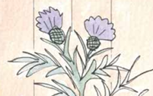
What would happen if we were all the same?
Dyslexia Scotland Charity No. SC000951 | dyslexiascotland.org.uk
© Wee Coaching Company

Slide 9


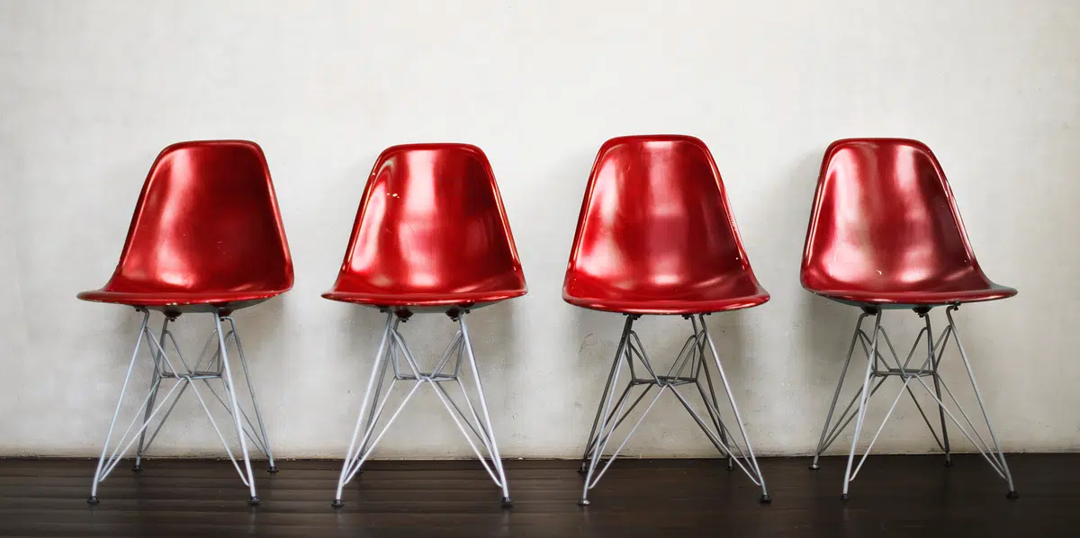
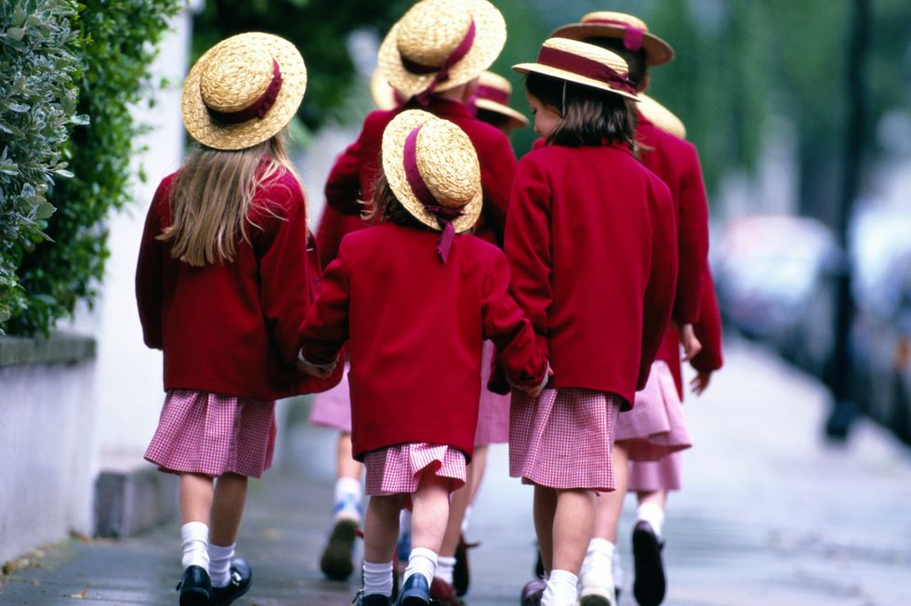
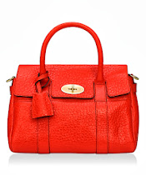
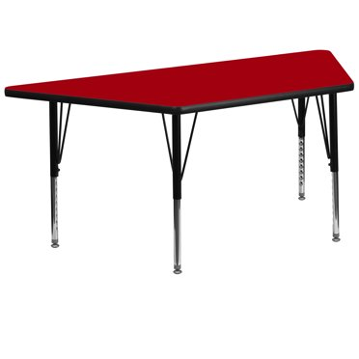

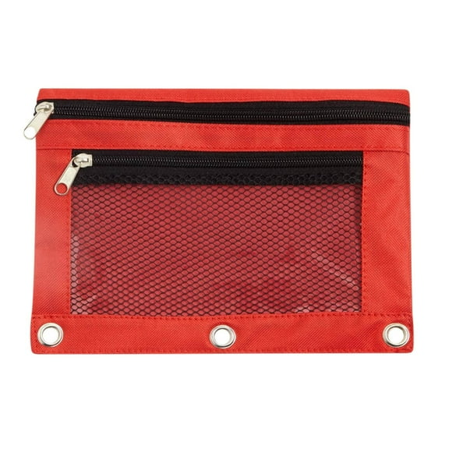
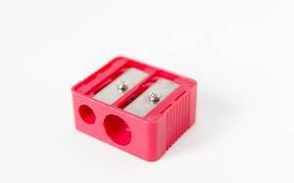


© Wee Coaching Company
This Photo by Unknown Author is licensed under CC BY
Notes:
This slide is animated to allow one point to be thought and discussed at time.
What if everything was the colour red? Questions to support the discussion:
What if all the chairs/desks/carpet was red?
What if we could only write with red pencil?
What would happen if everyone’s school bag and pencil was red and looked the same?
What colours would you miss? When do we use the colour red to help us? (Stop signs/red light/ red man) What might happen if all signs were red and all traffic lights were red?

Slide 10
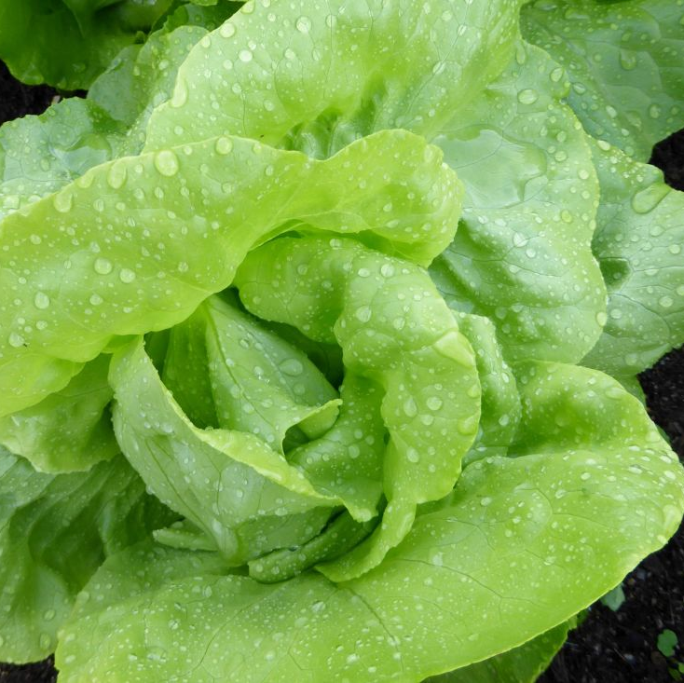
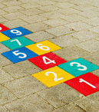


What if…?
© Wee Coaching Company

Slide 11
What helps me learn and thrive?
A quiet space
Talking to a friend/working with a shoulder partner
A hug or kind word
Extra time to think
Fresh air or moving about
A word bank or phonics bank to help me spell
Drawing my ideas or acting it out
Someone showing me what to do before I start
Practising over and over
Sitting on the floor or standing up to work
© Wee Coaching Company

Slide 12
We Reflect
We all learn and think differently,
but that's what helps us bloom.
Dyslexia Scotland Charity No. SC000951 | dyslexiascotland.org.uk
© Wee Coaching Company

Slide 13
Becoming Wise for
my Size
Nominations
Dyslexia Scotland Charity No. SC000951 | dyslexiascotland.org.uk
© Wee Coaching Company

Slide 14
Extension Ideas
Corners Game
What did these plants need? Move to the picture that matches your answer.
Dyslexia Scotland Charity No. SC000951 | dyslexiascotland.org.uk
© Wee Coaching Company
Notes:
Corners Game
Display the pictures of Little Flower, Daisy and Dandelion around the room; pupils move to the picture that matches their answer as the teacher calls out things these plants might need
(sunshine, water, shelter from the wind, soil, bark, shade etc.) Worksheet option is also available.
Further Discussion Prompts:
What is one thing that helps you feel good when you are learning?
How do you feel when something feels tricky?
Can you think of a time someone helped you?

Slide 15
Extension Ideas
Further Discussion Prompts:
What is one thing that helps you feel good when you are learning?
How do you feel when something feels tricky?
Can you think of a time someone helped you?
Dyslexia Scotland Charity No. SC000951 | dyslexiascotland.org.uk
© Wee Coaching Company
Notes:
Corners Game
Display the pictures of Little Flower, Daisy and Dandelion around the room; pupils move to the picture that matches their answer as the teacher calls out things these plants might need
(sunshine, water, shelter from the wind, soil, bark, shade etc.) Worksheet option is also available.
Further Discussion Prompts:
What is one thing that helps you feel good when you are learning?
How do you feel when something feels tricky?
Can you think of a time someone helped you?

