Slide 1


Support for Dyslexia in Scottish Schools:
Policy Guidelines and Available Resources

Slide 2
Adoption of the Scottish Working Definition of Dyslexia
To achieve a national approach to supporting children and young people with dyslexia it is recommended that all Education Authorities, teaching professionals and school staff make use of the Scottish Working Definition of Dyslexia.
The definition has been developed by the Scottish Government, Dyslexia Scotland, the Cross-Party Group on Dyslexia in the Scottish Parliament and a wide range of stakeholders. This includes agreement from the Association of Scottish Principal Educational Psychologists to use the working definition.
The aim of the working definition is to provide a description of the range of indicators and characteristics of dyslexia as helpful guidance for educational practitioners, children, parents/carers and others.
The Scottish Working Definition of Dyslexia
Dyslexia can be described as a continuum of difficulties in learning to read, write and/or spell, which persist despite the provision of appropriate learning opportunities. These difficulties often do not reflect an individual’s cognitive abilities and may not be typical of performance in other areas.
The impact of dyslexia as a barrier to learning varies in degree according to the learning and teaching environment, as there are often associated difficulties such as:
auditory and/or visual processing of language-based information
phonological processing – awareness, processing speed and / or memory
oral language skills and reading fluency
short-term and working memory
sequencing and directionality
number skills
organisational ability
motor skills and co-ordination may also be affected.
Click the link below for a full description:
Scottish Working Definition of Dyslexia.

Slide 3
Use of the Addressing Dyslexia Toolkit
The Addressing Dyslexia Toolkit is a free comprehensive online resource for all who are involved in the identification and support of learners aged 3-18 years who are showing signs of literacy difficulties. The website is funded by the Scottish Government, managed by Dyslexia Scotland and chaired by Education Scotland.
The resource provides information for teachers, schools and local authorities on inclusive practice, literacy difficulties and dyslexia. The Toolkit guides users through a child-centred, collaborative process of identification, assessment, support and monitoring of dyslexia.
The Toolkit provides guidance through the steps from initially identifying some early signs of difficulty in literacy development, ensuring appropriate teaching and support, evaluating that support, and where appropriate, considering whether the term dyslexia is appropriate.
About the Toolkit
The Toolkit is for all who work with pre-school and school-age children and young people in a professional educational setting and seeks to reassure that dyslexia is not a mystical or mythical problem that only specialist highly trained individuals can deal with. Everyone has the skills and abilities to recognise early signs of dyslexia in children at all stages and take appropriate action in response to support children and young people.
The toolkit:
Provides up to date information on dyslexia for teachers and local authorities set within the context of Scottish education.
Offers an identification pathway built on Curriculum for Excellence and which supports GIRFEC for all teachers to follow, enabling them to ensure that appropriate collaborative assessment and support are in place for learners with literacy difficulties such as dyslexia when they need it.
Offers guidance on the collaborative process of assessing literacy difficulties, which may be dyslexia.
Provides details of relevant approaches and strategies, using free sources wherever possible.
Click the link below for further information about the Toolkit:
About the Toolkit | Addressing Dyslexia Addressing Dyslexia

Slide 4
Open University free online learning modules - Dyslexia and Inclusive Practice
Three free online learning modules, which support GTC Scotland Professional Standards, Professional Update and Professional Recognition, have been developed for teachers, school management and GTCS registered local authority education officers.
The modules aim to:
Inform practitioners about ways in which they might engage in meaningful career-long professional learning in order to improve outcomes for children, young people and adults
Provide free and accessible opportunities to engage with professional learning
Support deeper learning and understanding of dyslexia and inclusive practice
Provide opportunities for participants to reflect on their practice regarding dyslexia and inclusion
Encourage all teachers to be familiar with, and make appropriate use of, the Addressing Dyslexia Toolkit and to encourage those working with adults to be aware of the range of resources available
To support teachers in achieving professional recognition for areas of enhanced accomplishment in their professional practice and to support those working with adults in their continuing professional development.
Online Learning Modules
Three learning modules, have been developed in response to Recommendations 1 and 2 of the 2014 Education Scotland Review: Making Sense of Dyslexia: Education for Children and Young People with Dyslexia in Scotland.
The modules are primarily for teachers, school management and GTCS registered local authority education officers.
The modules are:
Module 1: ‘Introduction to Dyslexia and Inclusive Practice’
Module 2: ‘Supporting Dyslexia, Inclusive Practice and Literacy’
Module 3: ‘Dyslexia: Identification and Support’
Click the link below for further information about the modules:
Free Online Learning Modules | Addressing Dyslexia Addressing Dyslexia

Slide 5

Dyslexia Scotland – Information and Resources
Dyslexia Scotland is a national charity providing a wide range of support, information, professional learning opportunities and resources to educators. The Charity works collaboratively with Education Scotland, the Scottish Government, partners, those with lived experience, families and educators to improve the educational experiences and life opportunities of children, young people and adults who are, or who may be dyslexic.
Dyslexia Scotland worked in partnership with Education Scotland and the Scottish Government to support the implementation of the of Making Sense Review’s recommendations.
Making Sense Programme: Final Report 2020 | Resources | National Improvement Hub
Dyslexia Scotland lead on the annual Scottish Dyslexia Awareness week each Autumn.
Dyslexia Awareness Week | Dyslexia Scotland - Dyslexia Scotland
Click on the link below to find out more about Dyslexia Scotland:
About Dyslexia Scotland | Dyslexia Scotland - Dyslexia Scotland
National helpline: 0344 800 8484
Free online learning
Member library and membership benefits
Newsletter
A range of downloadable support leaflets
Career guidance
Wide range of events including branch meetings across Scotland
Research

Slide 6
GTCS Dyslexia and Inclusive Practice Professional Recognition Programme
The Dyslexia and Inclusive Practice Professional Recognition Programme develops expert teachers to effectively identify and support learners with dyslexia in Scotland. By gaining Professional Recognition in Dyslexia and Inclusive Practice, educators become better equipped to identify and support learners with dyslexia. The programme supports teachers to learn in depth about an aspect of identifying and supporting dyslexia. Practitioners are then encouraged to take a thematic leadership role within their learning establishments, cascading the professional learning and supporting colleagues to adopt good practice approaches to dyslexia identification and support. Learners with dyslexia benefit from the improved awareness, support and wider inclusion within the school or college community.
The programme is co-delivered by Dyslexia Scotland and Education Scotland, working closely with the Addressing Dyslexia Toolkit working group to ensure a high standard of training and resources. It aims to increase the number of GTCS registered teachers with dyslexia and inclusive practice professional recognition and is supporting the growing community of practice across Scotland. Education Authorities are encouraged to support teachers to participate in the annual programme.
Programme structure (The course lasts one year)
Three Masterclasses (September/October; February/March; May/June). Participants are expected to carry out intersessional study, practitioner enquiry and collaboration with peer learners between each masterclass, as set out below.
Participants’ own study: online Open University Dyslexia and inclusive practice Module 3. When doing the modules, learners are encouraged to use a Reflective Log.
Practitioner enquiry, involving personal reflection as well as collaboration with colleagues and their school community; this is linked to Module 3, on the broad topic of dyslexia and inclusive practice, with individual areas of research to be agreed and explored as part of the programme discussions, taking into account existing research and emerging gaps including the ‘bank’ of evidence and learning from pilot practitioner enquiries.
GLOW Team space for sharing ideas and practice
One Professional Recognition Reflective Support day
Submission of Professional Recognition application

Slide 7
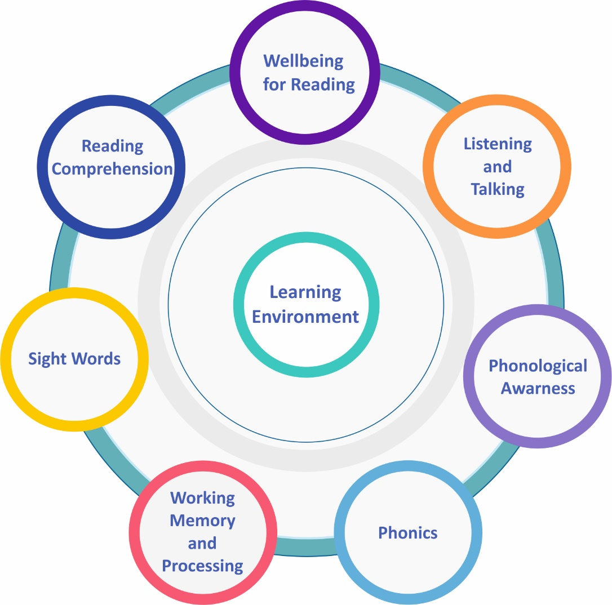
The Reading Circle
The Reading Circle is a comprehensive downloadable resource designed to help educators gain an understanding of how literacy skills have developed for the child or young person they are working with who may be experiencing literacy difficulties.
The Reading Circle can be used in early learning, primary and secondary settings and may also be beneficial for children and young people for whom English is not their first language, as well as for adults. Developing as a reader is linked to positive attitudes and experiences, as well as skills. Curriculum for Excellence recognises the fundamental importance of reading for enjoyment within the reading experiences and outcomes.
The Reading Circle provides:
Descriptions of the key areas involved in the acquisition of reading skills
Approaches to help understand and support reading difficulties
A discussion/planning tool to record discussions with colleagues, staff and, where appropriate, the learner. The planning tool can highlight strengths and difficulties and offer guidance to plan the next steps appropriately.
Click the link below for further information about the Reading Circle: Reading Circle | Addressing Dyslexia Addressing Dyslexia

Slide 8
September 2025

