Slide 1
What is dyslexia?
Dyslexia Awareness Week
30 September - 6 October 2024
Dyslexia Scotland
Cameron House
Forthside Way
Stirling
FK8 1QZ
Helpline: 0344 800 8484
info@dyslexiascotland.org.uk
Charity No. SC 000951

Slide 2
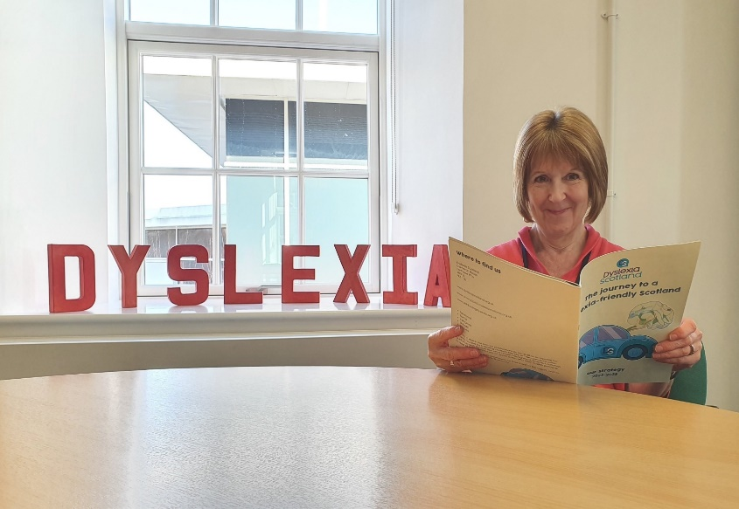
Dyslexia is a learning difference
As well as difficulties with reading, writing and spelling, dyslexia can also affect:
- Short term memory
- Organisational skills
- Sequencing skills such as following instructions or directions
It is important to remember that everyone with dyslexia is different and not everyone will experience all of the difficulties listed above.

Slide 3
Dyslexia is common
1 in 10 people are dyslexic
Of those, 1 in 4 has severe dyslexia
It often runs in the family
It is lifelong
It ranges from mild to severe

Slide 4
People with dyslexia might struggle with:
Reading, writing, spelling
Planning and prioritising
Time keeping
Sequencing and instructions
Distractions such as background noise

Slide 5
People with dyslexia are often good at:
Problem solving creatively
People skills/interaction
Seeing the bigger picture
Different ways of thinking

Slide 6
Important
Dyslexia is not related to intelligence.
Many successful business people and entrepreneurs are dyslexic.
The crucial thing is that people with dyslexia are supported at school and with reasonable adjustments at work if needed.

Slide 7
Dyslexia Scotland
A membership organisation
A network of volunteer-led branches across Scotland
Adult Networks
Helpline 0344 800 8484 or helpline@dyslexiascotland.org.uk
Tutor and Assessor lists
Dyslexia training

Slide 8
Join Dyslexia Scotland today
dyslexiascotland.org.uk/join

