Slide 1
What is dyslexia?
Dyslexia Awareness Week
2024
Dyslexia Scotland
Cameron House
Forthside Way
Stirling
FK8 1QZ
Helpline: 0344 800 8484
info@dyslexiascotland.org.uk
Charity No. SC 000951

Slide 2
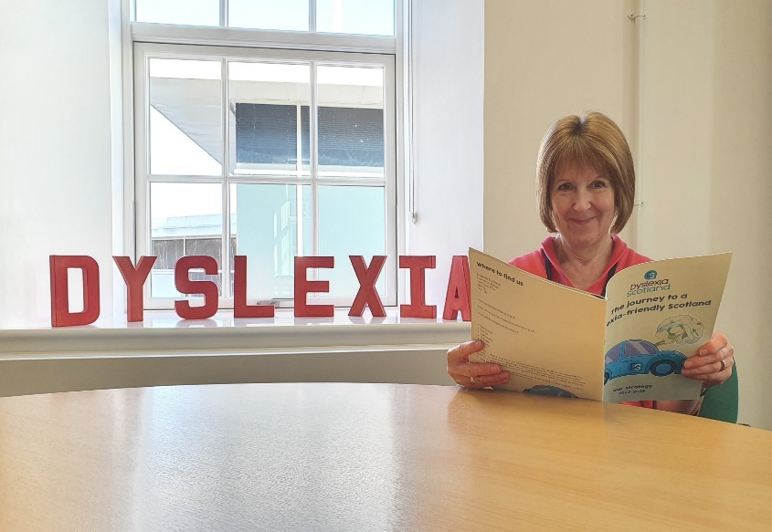
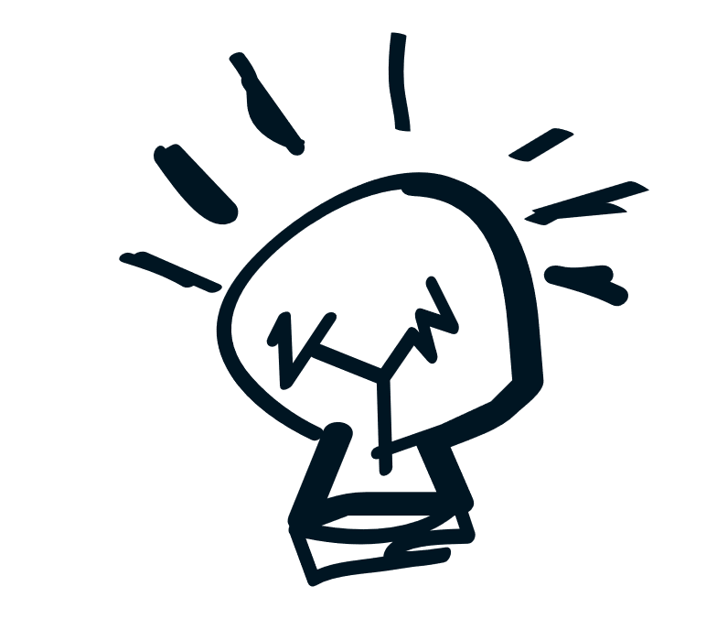
People with dyslexia learn in a different way
Someone with dyslexia can struggle with reading, writing and spelling. Dyslexia can also make it harder for them to:
Remember some things
Organise things
Follow instructions or directions in the right order
But everyone with dyslexia is different!

Slide 3
Lots of people have dyslexia
1
10
in
people are dyslexic
It often runs in the
family

Slide 4
People with dyslexia might struggle with:
Reading, writing, spelling
Planning and organising
Timekeeping
Following instructions in the right order
Distractions, like background noise

Slide 5
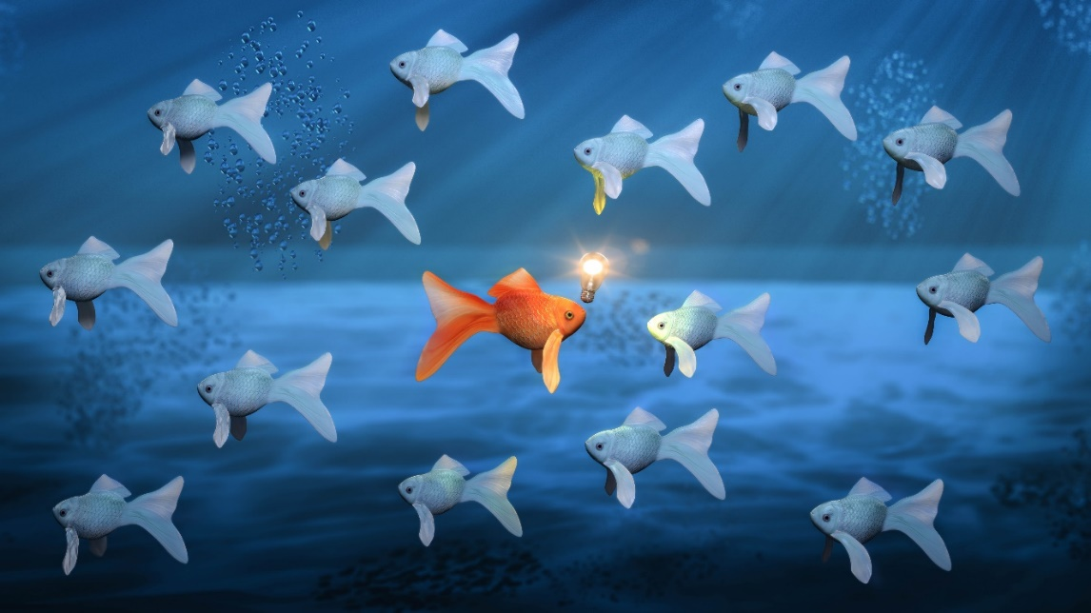
People with dyslexia
are often good at:
Solving problems creatively
Using their imagination
Understanding other people
Seeing the bigger picture
Thinking differently

Slide 6
It’s important to remember…
People with dyslexia aren’t more or less intelligent than people who don’t have it
Many successful people are dyslexic
If people with dyslexia get the help they need, they can do anything!

Slide 7
Activity:
Create a comic character who has dyslexia
Use slides 4 and 5 to help you design their personality – remember that people aren’t only dyslexic – they can be funny, creative, athletic and naughty as well!
Make a comic story about a day in your character’s life. What challenges do they have? What strengths do they use to get past their challenges?

Slide 8
Activity:
TOP TIPS TO GET YOU STARTED!
If you can’t think of a name for your character, use your own – you can always change it later!
Ask yourself “what if..?” questions.
What if your character needs to do something?
What if they meet someone famous?
What if they find themselves in a pickle?

