Slide 1
Dyslexia Awareness Week
1 - 7 November 2023
Dyslexia Scotland
Cameron House
Forthside Way
Stirling
FK8 1QZ
Helpline: 0344 800 8484
info@dyslexiascotland.org.uk
Charity No. SC 000951

Slide 2
What is dyslexia?
Dyslexia is a learning difference that is common
The brain simply works in a different way
Dyslexia has nothing to do with intelligence
Everyone with dyslexia is different

Slide 3
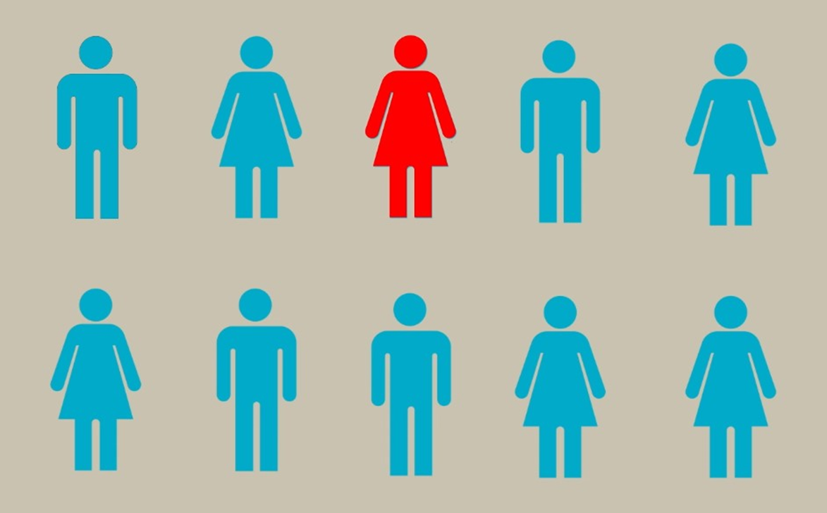
How many people are dyslexic?
1 out of every 10 people is dyslexic

Slide 4
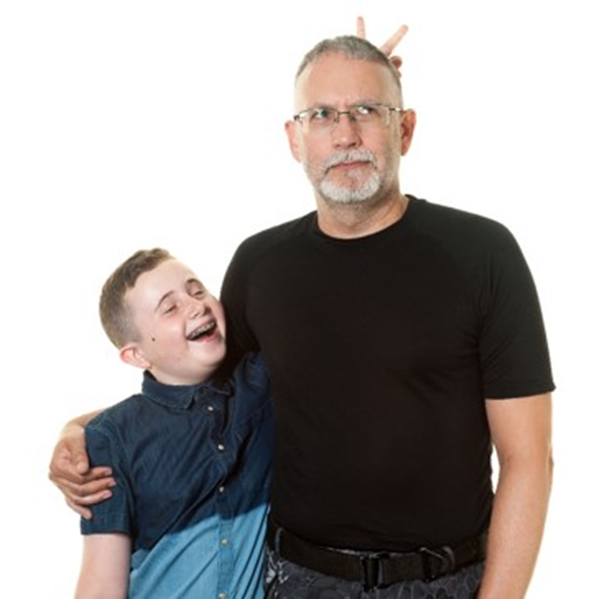
Did you know?
Dyslexia often runs in the family.
Brennus and his dad are both dyslexic.

Slide 5
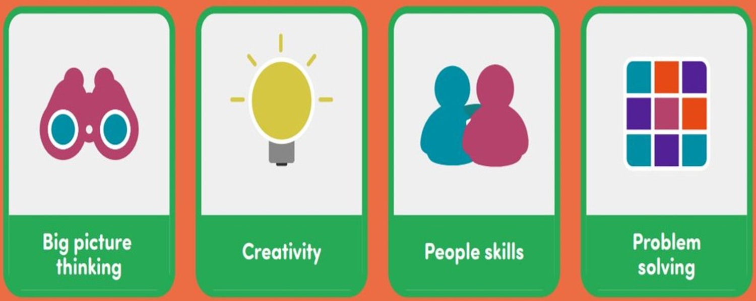
Dyslexic strengths

Slide 6
Dyslexic challenges

Slide 7
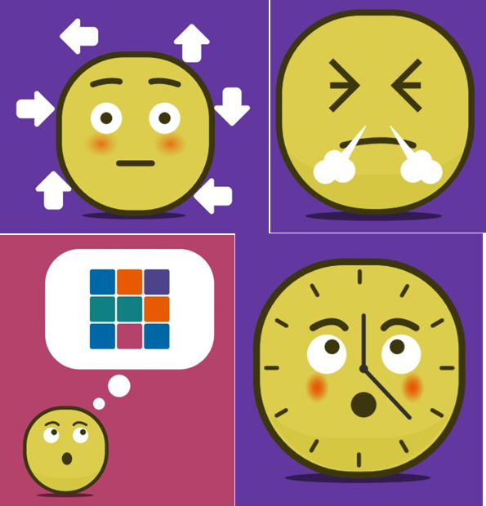
Dyslexia can make some people feel…
Tired
Angry
Embarrassed
Confused
Sad
Like they are no good…

Slide 8
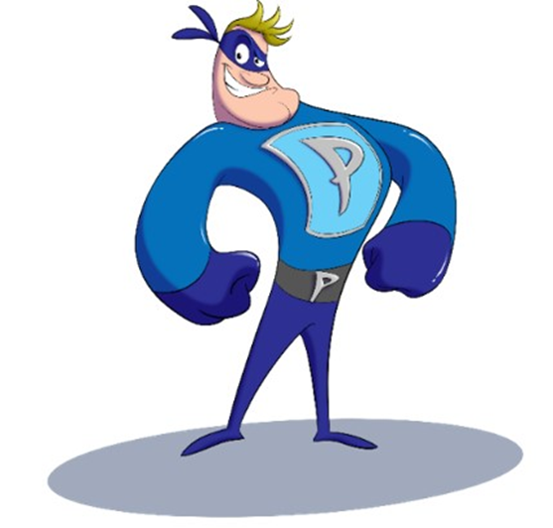
But some people feel that dyslexia is like having a superpower!
Once they find the things that will help, they can do anything.
There are lots of people who can help. People like parents, friends, teachers and employers.
Image copyright Mission Superheroes

Slide 9
Some of the most famous and successful people in the world are dyslexic…
Actors
Entrepreneurs
Inventors
Chefs
Explorers
Lawyers...
Can you name any well known dyslexic people?

Slide 10
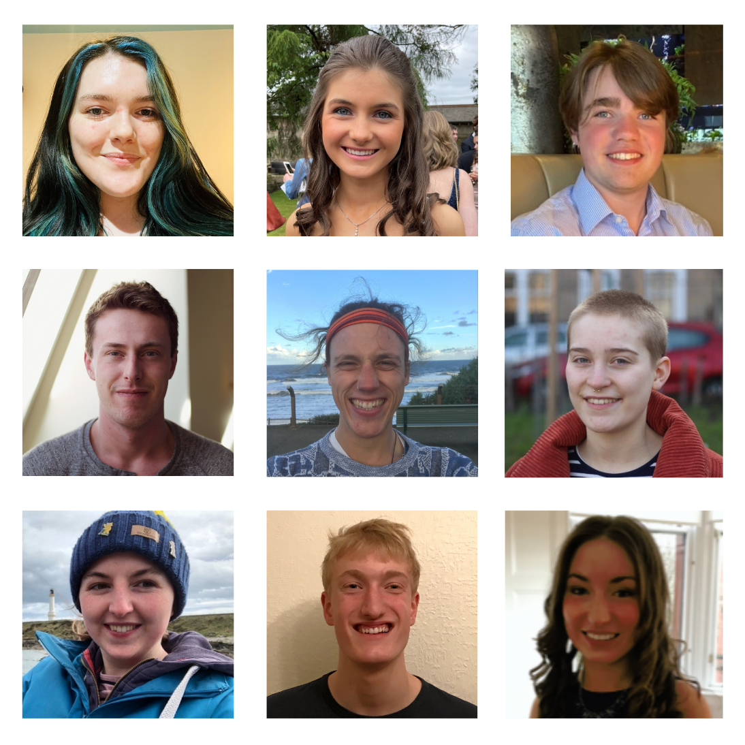
You don’t need to be famous to succeed…
…but Dyslexia Scotland’s Young Ambassadors are pretty special.

Slide 11
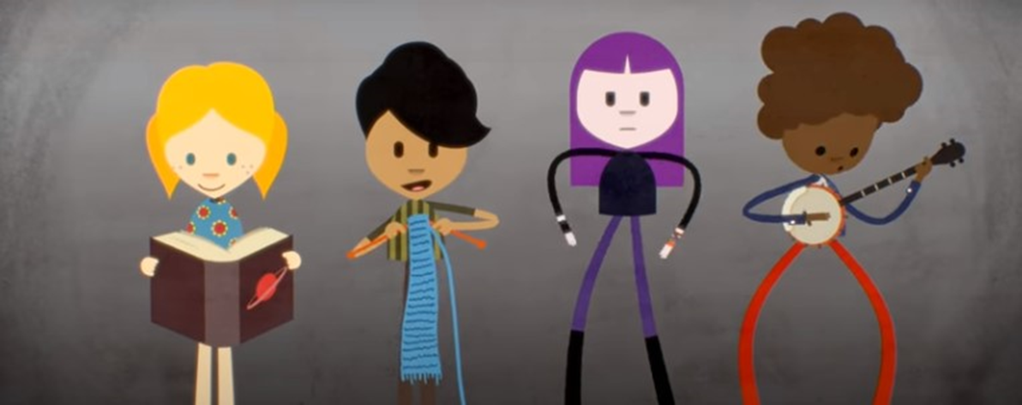
Want to know more?
Watch this short film called ‘See Dyslexia Differently’

Slide 12
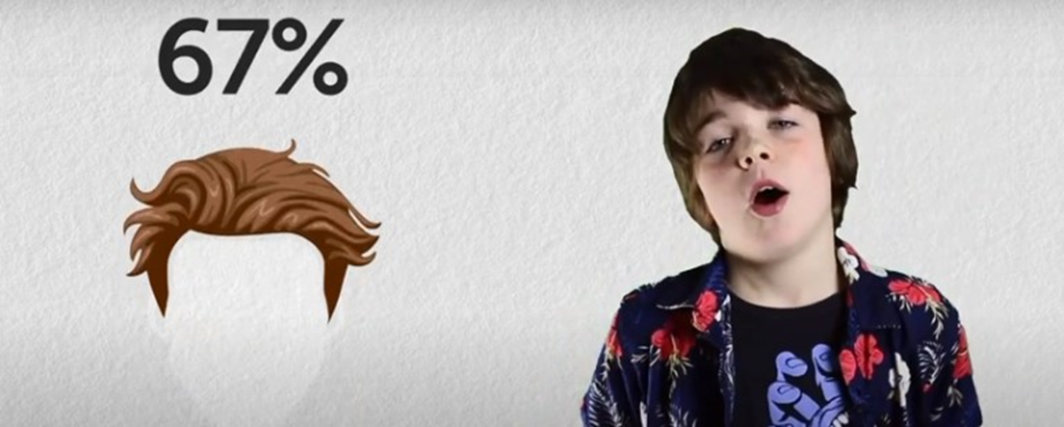
Miles thinks dyslexia is rubbish – and awesome
Here’s another short film – Miles give you the lowdown on his dyslexia

Slide 13
Want to hear more stories?
There’s a great website for children and young people aged 8 -18 with dyslexia.
dyslexiascotland.org.uk/unwrapped/

