Slide 1
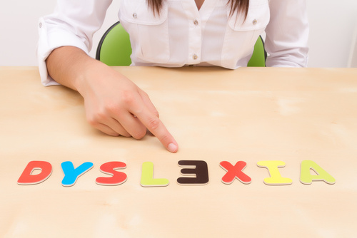
What is dyslexia?

Slide 2
How many people have dyslexia?
1 in every 10 people has dyslexia.
It often runs in families.
Notes:
Ask if anyone knows how many people have dyslexia. Click the button for the figure of ‘1 in 10’ to appear. Say that 1 in 4 of these people have severe dyslexia.

Slide 3
Dyslexia can be...
Finding it hard to read because you can’t match sounds to the letters in words. . .
. . . and you may lose the place a lot when you try to concentrate
. . . and you may forget what you have just read so nothing makes any sense
And don’t even mention reading out loud!!!!

Slide 4
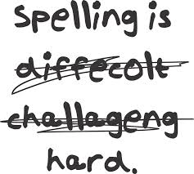
Dyslexia can be...
Finding it hard to learn how to spell words and write them down.

Slide 5
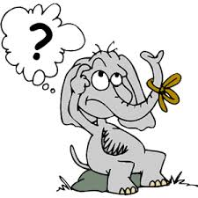
Dyslexia can be...
Finding it hard to remember things, like:
instructions or directions
what you need to take to school each day

Slide 6
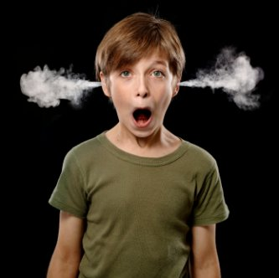
Dyslexia can be...
When things just escape from your memory. . . like numbers to add in sums. ..

Slide 7
Dyslexia make you feel...
Tired
Angry
Embarrassed
Confused
Sad
Like you are no good

Slide 8
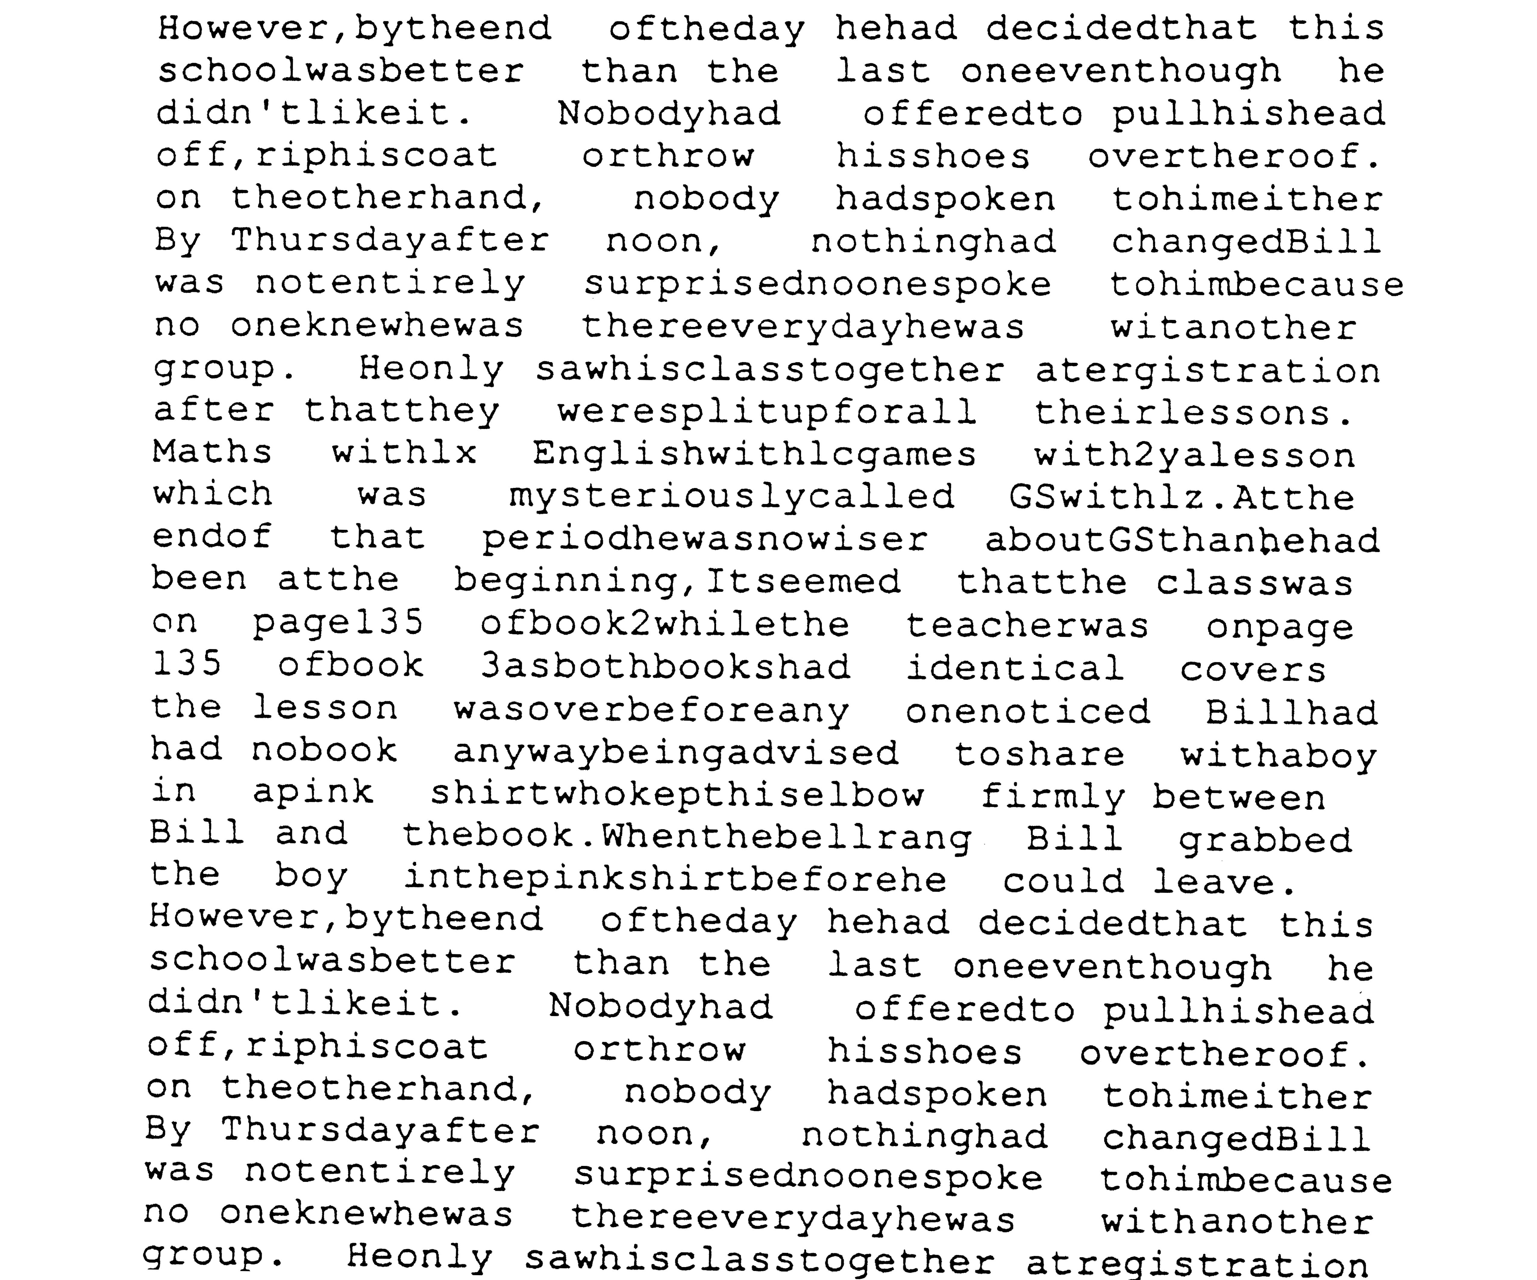
Visual issues
Some people with dyslexia have visual stress. Words move when they try to read.
Notes:
This does not happen to everyone with dyslexia.
It can cause headaches when it does happen.

Slide 9
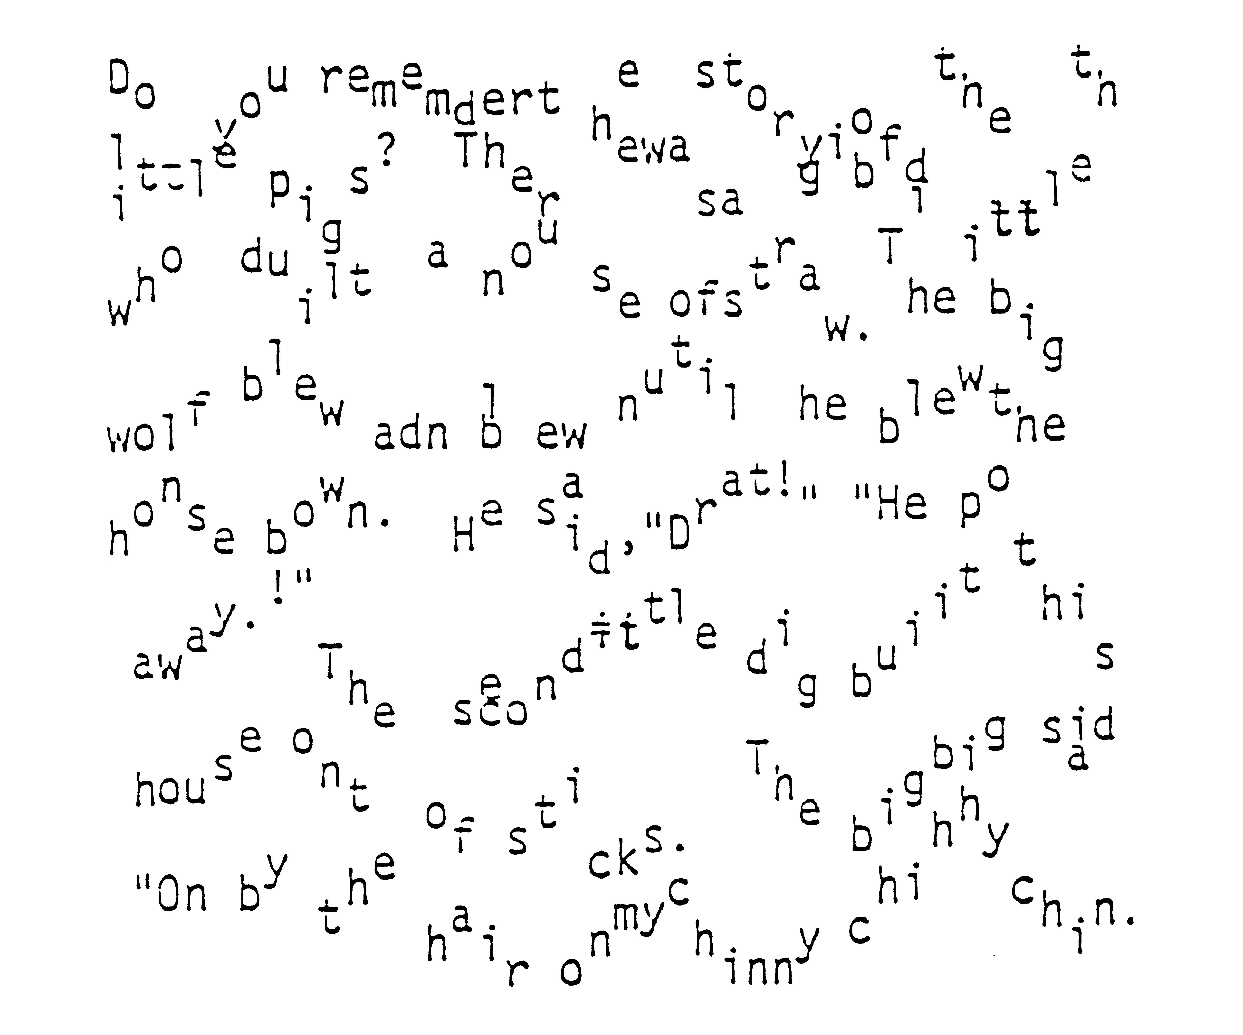
The Seesaw effect
Here’s another example of how it can be hard for people with dyslexia to read.
Notes:
Here is another example of how it can be hard to read.
Can you see how difficult it would be to read this?
Remember though, not everyone with dyslexia has these problems.

Slide 10
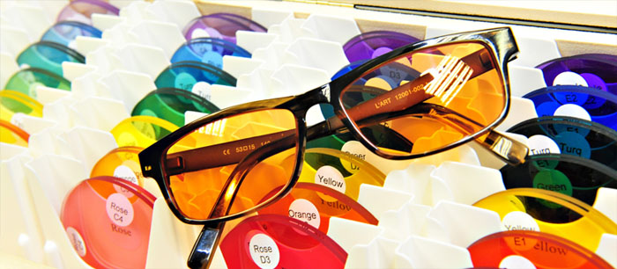
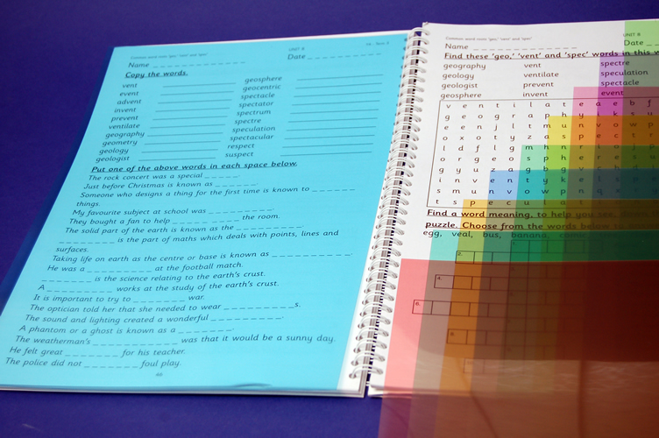
Visual stress
Some people with visual stress find that coloured glasses or overlays help.
Notes:
Specialist opticians can carry out eye tests for this.

Slide 11
Say the colour not the word!
Try naming the colours below to find out what it is like when your brain has to work extra hard. It can be like this for people with dyslexia.
Red Blue Pink Yellow Green
Purple Orange Yellow Pink Brown
Purple Blue Red Yellow Red
Red Blue Pink Yellow Green
Purple Orange Brown Purple Blue
Blue Red Purple Blue
Blue Red Yellow Red Blue
Pink Yellow Green Purple Orange
Brown Purple Blue Blue Red
Notes:
Exercise
Ask people to read out load the colours not the word.
So they should say:
Green, orange, blue, black, red and so on.
The idea of this exercise is to show what it’s like when your brain has to work extra hard – and it can be like this for children with dyslexia.

Slide 12
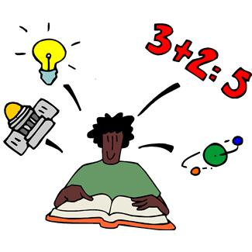
People with dyslexia are not ‘stupid’
Dyslexia has nothing to do with intelligence. Some of the most successful and well known people in the world are dyslexic.
Being dyslexic just means that your brain learns things in a different way.

Slide 13
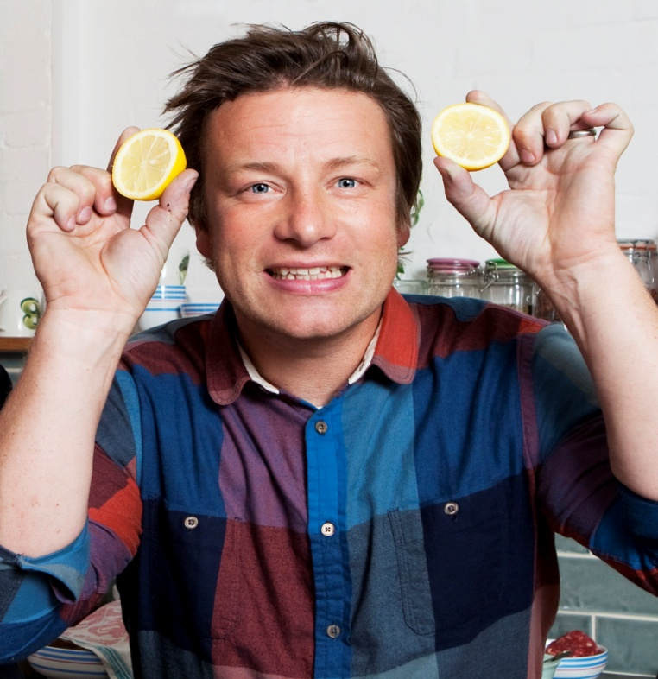
Being dyslexic does not mean that you can’t do well and succeed in life!
Notes:
The photos are of chef Jamie Oliver, chef and Lord Allan Sugar, business man and star of ‘The Apprentice’ .

Slide 14
Did you know...?
GCHQ is the part of the Government that tries to keep us safe from spies and terrorists.
GCHQ employs lots of people with dyslexia because they can be really good at cracking codes that others find hard!

Slide 15
People with dyslexia can be...
Good at having new ideas

Slide 16
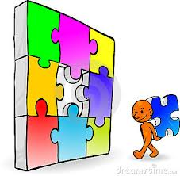
People with dyslexia can be...
Brilliant at solving problems

Slide 17
People with dyslexia can be...
Fantastic at sport

Slide 18
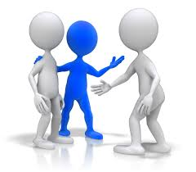
People with dyslexia can be...
Good at meeting and speaking with people
Notes:
If you have dyslexia, why don’t you talk about some of the things you are good at and some of the things you are most proud of?

Slide 19
Important!
Everyone with dyslexia is different.
Not everyone has the same problems.
Everyone with dyslexia is good at some things.
Different things help different people.

Slide 20
What can help?
Computer apps and technology
Coloured paper and overlays or glasses
Having help with reading and writing in school
Being allowed extra time in exams
What helps most is when people understand more about dyslexia!

Slide 21
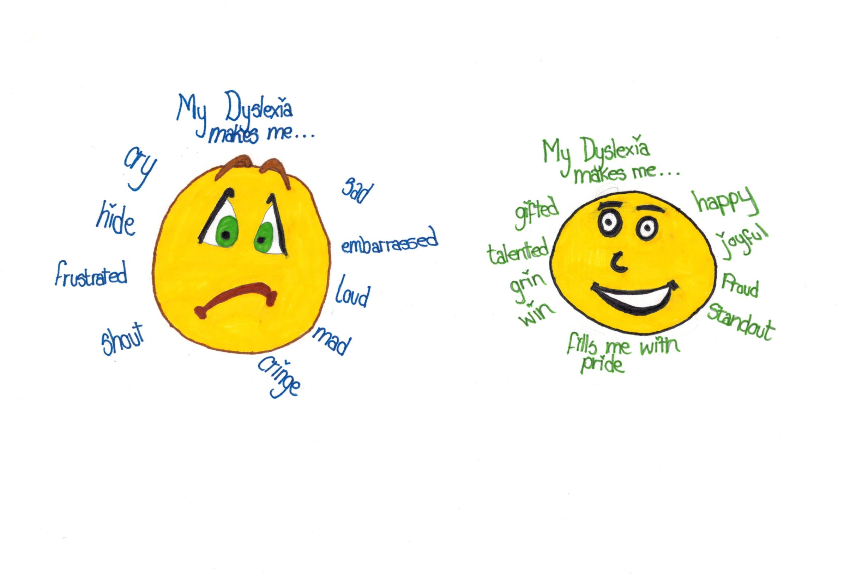
Notes:
Here is what a girl called Ellie drew to show how her dyslexia makes her feel.
Ellie came up with the idea of people wearing blue ribbons during Dyslexia Awareness Week to show their support and to help children know that it’s nothing to be ashamed about.

Slide 22
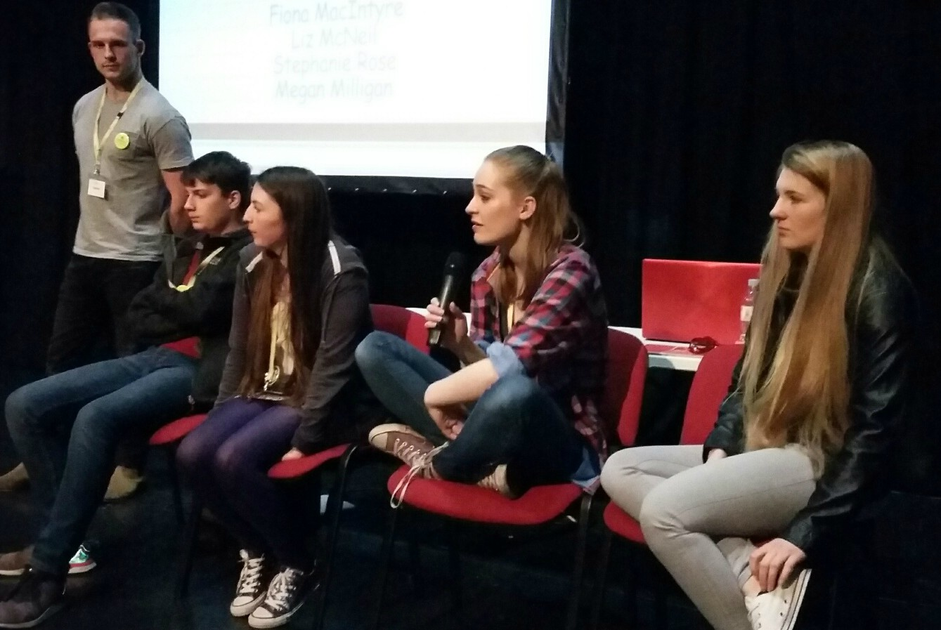
Dyslexia Scotland Young Ambassadors
Young people with dyslexia tell Dyslexia Scotland about the things that are important to them.
Notes:
Dyslexia Scotland has a group of young people to tell them about their experiences and to pass on to others that dyslexia is nothing to be ashamed about.

Slide 23
Dyslexia Unwrapped
Visit our new website for children and young people with dyslexia after 9 November at:
unwrapped.dyslexiascotland.org.uk
Charity No: SC000951 Reg No: SC153321

Slide 24
Some short film clips you can watch:
I am Me Scotland – Judged
Dyslexia – think how you learn
When I was Seven – poem by Lyla

